Slide 1
Policing Drunkenness in Cumbria, 1856-1901The Cumberland and Westmorland Constabulary
Dr Guy Woolnough
School of Criminology and Sociology
Keele University
g.woolnough@keele.ac.uk
Notes:
I am researching the early police forces of the second half of the nineteenth century, particularly the discretionary policing of petty crime. The police are an organisation where the scope for discretion increases as one goes down the hierarchy. It is this exercise of discretion that interests me most, because this is where one may observe the plebeian cultures of the policemen influencing their daily work. The policing of drink is an obvious example, for the police clearly do not and never did arrest every drunk and disorderly person. How did they decide who needed arresting? To answer that I have been looking at the work of the police at the lowest level, on the streets and lanes of Cumbria. This paper shows that there is evidence to support the view that levels of arrests for drunkenness were heavily influenced by local cultures.

Slide 2
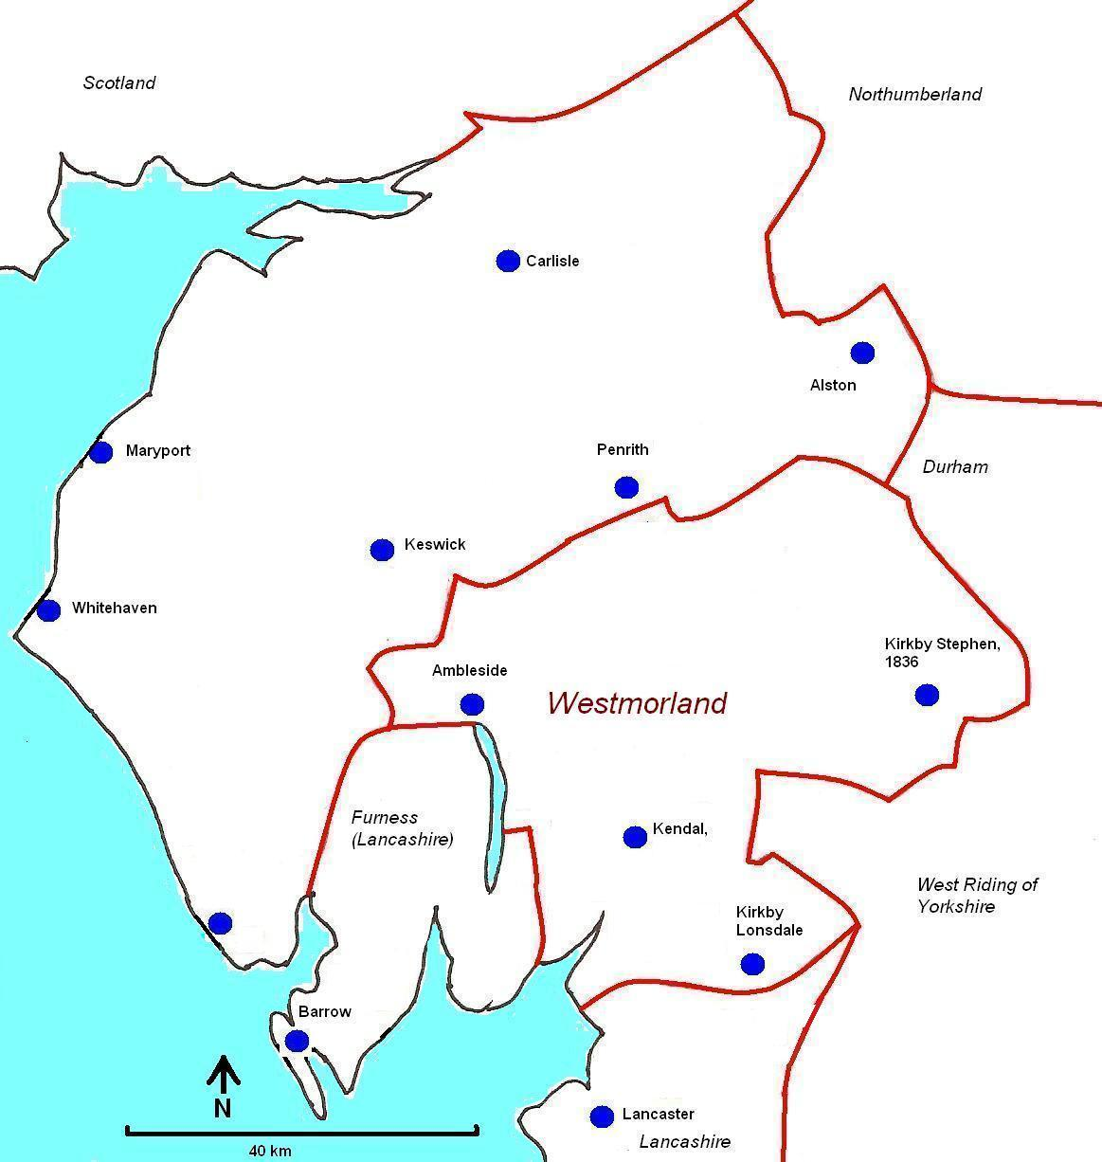

Kirkby Stephen
Pennine town in the county of Westmorland
Kirkby Lonsdale
Notes:
Kirkby Stephen is a small, isolated Pennine town. 25 miles from Kendal. KS population was 1500 in 2nd half of 19th cent, v little growth, the industrial revolution passed by with little impact, though railways did pass through. The east of Westmorland is Pennine, not the Lake District. KS is about 25 miles from Kendal, the county’s largest town, pop about 15000 in 1880s.
Cumberland and Westmorland had a joint constabulary (2 counties with a joint force was unique) Men were transferred across the region. This paper will refer to Kirkby Lonsdale also.

Slide 3
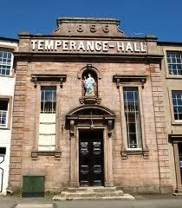
Kirkby Stephen
Population c.1500
The Temperance Movement
Four Temperance Inns, one Temperance Hall, four Bands of Hope, one Rechabite ‘tent’, and an annual Temperance Demonstration
Shepherd, M.E., 2003. From Hellgill to Bridge End : aspects of economic and social change in the Upper Eden Valley 1840-95.
Notes:
Temperance enjoyed a great deal of support in Kirkby Stephen. 1885: population 1500: Four Temperance Inns, one Temperance Hall, four Bands of Hope, one Rechabite ‘tent’, and an annual Temperance Demonstration: in 1880, 3000 children present, eight brass bands, gymnasts, pipers, dancers, and 3,300 people marched. These gatherings continued up until the 1990s. KS and Pennine Westmorland was a Temperance hot spot. (BHarrison, Religion and Recreation, Past & Present. Social role of church.)

Slide 4
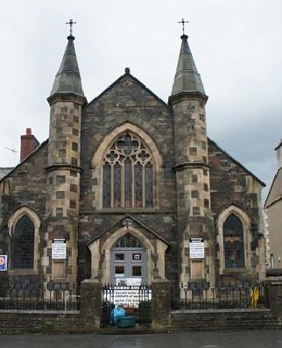
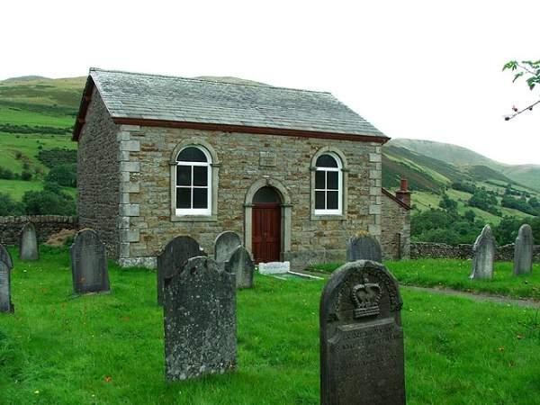
Methodism
Kirkby Stephen Primitive Methodist Chapel, rebuilt 1902
Cautley Wesleyan Methodist Chapel, built 1865
1851 Religious census: Kirkby union attendance, 71%
Clarke, D.F., 1983. An Isolated Holy Community: Methodism in the Upper Eden Valley, Westmorland.
Burgess, J., 1980. A history of Cumbrian Methodism.
Notes:
Kirkby Stephen was also a centre of Primitive Methodism. There were a great number of new chapels built in the East Ward after 1851. (Clarke 1983: 84; Burgess 1980: 89-90) Church attendance in Cumbria was the second lowest in England, at 37.3% (Gray 2012: 234). However, the rate of attendance in the East Ward (including Appleby and Kirkby Stephen) was one of the highest in the country, at 71%. Primitive methodism grew in mid to late 19cent in East Ward. (England 48%) Kirkby Stephen was at the centre of a strongly Methodist and Temperance district. Temperance and Methodism were not coterminous, but there was a lot of overlap.

Slide 5
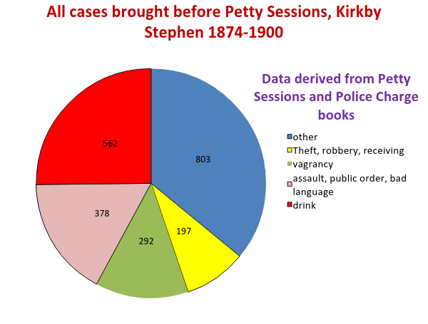
Notes:
I have looked at the lowest level of the criminal justice system, the Petty Sessions, where the magistrates dealt with the most trivial cases. The police charge books give a wealth of detail, so one can discover who the person was (age, trade, address, and more) what exactly he/she did, exactly where, when etc.The town of Kirkby Stephen (population c1500) has provided a comprehensive set of data, which enable a careful examination of what was actually happening. These are the cases heard by the petty sessions over 25 yrs. Drink was the largest category of offence, followed by assault and public order offences, many of which were drink related.

Slide 6
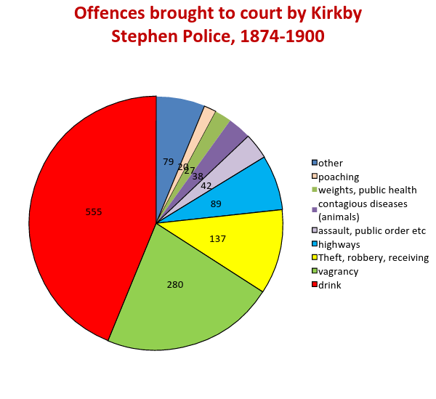
Notes:
Here I have taken out all the privately prosecuted cases. Shown here are the cases brought to court by the police and prosecuted by the police. Vagrancy and drink become an even larger proportion of the cases. The cases which have fallen away are assault, most of which cases were privately prosecuted, often when two people took each other to court at the end of a row. Bastardy, school attendance and payment of rates also largely disappear., also almost one third of the theft cases. Two thirds of the cases dealt with by police were drink or vagrancy cases, where police discretion was at its greatest. (Drink: drunk and disorderly, drunk and incapable, drunk in charge of child or horse or cart, drunk on licensed premises, on licensed premises after hours. Vagrancy: several causes of arrest: begging, sleeping rough, loitering with intent, indecent exposure, hawking without a licence)

Slide 7
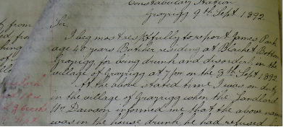
Police Discretion
A drunk, summonsed after an incident at Grayrigg, in 1892
From the station Occurrence Book
Notes:
The statement of an ordinary police constable who has dealt with a disorderly drunk. When a PC wanted to charge a drunk, he had to complete a report for his inspector and Superintendent, who had to endorse his statement before the charge could be issued. The police statements are a fascinating narrative, in which the PC details exactly what happens, or what he claims happened. Unfortunately, very few of these statements have survived, because once the case came to court these documents had no use , so were destroyed. I have none of these statements from Kstephen, but this is from Grayrigg, a few miles away. A lot of these have survived from Maryport, a very different place from KStephen, but the police statements are very similar. The PC was always very reluctant to charge the man, even more reluctant to arrest. The offender was given several opportunities to go home, the charge was only issued after the man had ignored several warnings.
The man was warned several times, he swore at the policeman and at other people, refused to go home. the above named was in the house drunk and had refused him any more drink and was very quarrelsome and was drinking other peoples glasses, I entered the house when the above went out, he wanted to enter the house again, when I stopped him at the door and told him that I would not allow him to enter as he was drunk and had been very quarrelsome, I told him that he had better go away home, he attempted several times to enter the house he then commenced swearing and did not care for a buggar like me, he kept walking and staggering about the village for about 3/4 of an hour, he then went away home with a neighbour. There were good reasons for not arresting this man. An arrest would mean walking with the prisoner to Kendal, 5.5 miles. But even in town, police avoided arrests and summonses by giving several warnings.
There are many similar reports, all of which describe repeated refusal to comply or to cooperate. No one was charged without at least four acts of disorderly defiance. This discretion was sanctioned by the chief constable who ordered his men to avoid arresting drunks if at all possible, and to avoid confrontations. Charges for drink offences only happened when a policeman thought there was very good reason.

Slide 8
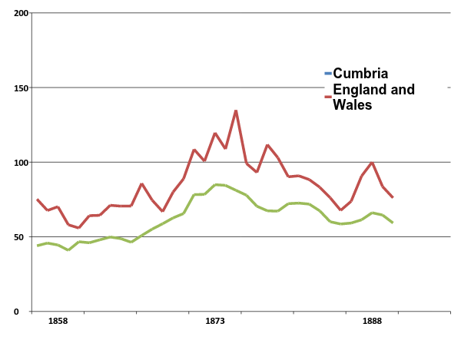
Persons charged with drunkenness offences,
1858-1892
From Judicial Statistics
Expressed per 10000 of population
Notes:
This data is taken from the Judicial statistics, the returns given every year about the number of people charged. Many of the secondary sources do say that there was a peak in drinking in the 1870s, which is reflected in this graph. However, this does not show levels of drunkenness, it shows police activity. It only shows how many people were arrested, it tells us nothing about how drunk they were, it says nothing about alcohol consumption. Cumbria was a region where the temperance movement was strong: within Cumbria, places with stronger temperance showed higher levels of charges for drunkenness. The 1870s was the high point of the Temperance campaign, and I believe that arrests peaked because of police attitudes to drink, rather than because of how much people were drinking.

Slide 9
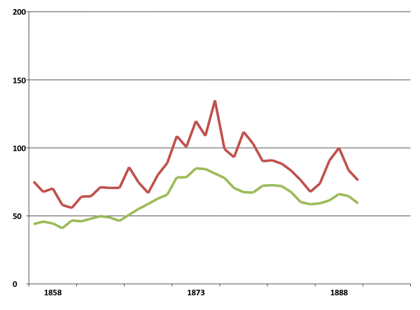
Liverpool
Kirkby Stephen, 1870s
Expressed per 10000 of population
Notes:
The figures for Liverpool in the mid-1870s were way over 200 prosecutions per 10000 of population, whereas in Kirkby Stephen the figure for the 1870s was about 130 per annum. Liverpool, a port city, notorious for heavy drinking, had rates of conviction that were amongst the highest in Eng, but Kirkby Stephen’s rates were also surprisingly high. (There are problems working out the rate for Kstephen, because the number of offences are low, so the figure of 130 is arrived at by averaging the figures for 10 years. It is a trend line, not a precise rate)

Slide 10
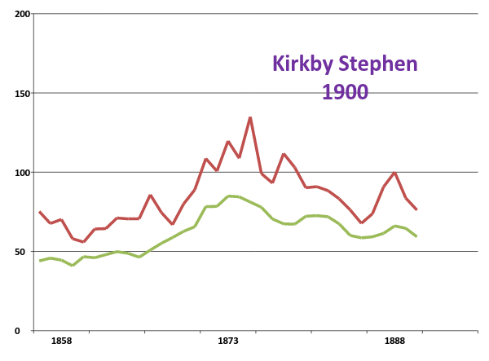
Expressed per 10000 of population
Notes:
By 1900 arrests for drink had fallen considerably in Liverpool and Cumbria, but they had gone up in Kirkby, so that the rate of drunkeness was higher than Liverpool. Why was Kirkby a drunken place? Or did the police apply different criteria?

Slide 11
Arrests and Summonses, Kirkby Stephen and Kirkby Lonsdale (1893-1900)
Same size population, same county,
same police force, same agriculture.
 | Kirkby Stephen Temperance | Kirkby Lonsdale Tourism
Drink offences | 216 | 79
Vagrancy offences | 36 | 82
Notes:
I needed to compare Kirkby Stephen with somewhere similar, and found a very good match in Kirkby Lonsdale. In order to avoid complicating factors like the presence of Navvies, there were only seven years where I could make a valid comparison. The figures surprised me. Did they have more drunks in K Stephen, and more beggars in K Lonsdale, or were the police making different discretionary decisions? Were the people of Kirkby Stephen heavier drinkers despite Temperance, or were the K Stephen police less tolerant of drinking? Was KLonsdale plagued with more beggars? The two Kirkbys were remarkably similar, but there are interesting differences. KS was heavily Temperance, whereas the Temperance movement was much smaller in KL (Trade directories show Bands of Hope, temperance inns, Rechabite lodges and more) KL was an important tourist spot attracting well off visitor: JMTurner painted there 1820s/30s, which boosted the town’s fame, Ruskin visited and said the town boasted the possible finest view in England and therefore possibly the finest in the world. (This is difficult to find in Ruskin’s writing, but the Tourist Info in the town still promote this ‘quote’ today and ‘Ruskin’s view’ was laid out in the 19th cent.)
Distance KS to KL: 34 miles. KS to Kendal, 25 miles.

Slide 12
Arrests and Summonses for Drink offences Kirkby Stephen and Kirkby Lonsdale (1893-1900)
 | Kirkby Stephen | Kirkby Lonsdale
Non vagrants | 158 | 69
Vagrants | 58 | 10
Vagrants charged as % of total charges | 27% | 13%
Notes:
The Police Charge books state the residence of the person charged, so I separated out those who had a fixed address, whether they were local or not, from those who were described as ‘no fixed address.’ I used these people as a control group, because I reckoned they would be the same sort of people in both places. They would drink in a similar way, they would have a similar amount of money, they would sleep rough or beg in the same way whether they were in Kirkby Stephen or Lonsdale. It was clear that more vagrants were arrested for drunkenness in Kirkby Stephen. The number of vagrants arrested was much the same in both places: the chances of being arrested was much the same for vagrants in both places, what was different was the charge used to effect an arrest. So looking at drink charges, more than a quarter of those charged with drink offences in KS were vagrants, in KL only 13% of those arrested for drink were vagrants.

Slide 13
Arrests and Summonses, Kirkby Stephen and Kirkby Lonsdale (1893-1900)
 | Kirkby Stephen | Kirkby Lonsdale
Vagrants charged with drink offences expressed as a percentage of all vagrant offenders | 31% | 5%
Notes:
It is even more striking when one sees what vagrants were charged with. More than 30% of the vagrants charged in K Stephen were charged with drinking offences, whereas in K Lonsdale, only 5% of vagrants charged faced drink related charges. The police in both towns were looking out for vagrants. This is typical of Victorian policing everywhere in Eng, strangers, outsiders and vagrants were watched carefully and more likely to be arrested. In Kirkby Stephen, more than 30% of vagrants were charged with drink offences, in Klonsdale only 5%. Drinking was what most troubled the general public in KS, it was a plebeian concern. Arresting undesirable outsiders for this offence satisfied local temperance attitudes in KS. In KL, begging was the deplored activity, and this is what vagrants were most likely to be arrested for. Local businesses did not want their respectable visitors put off by beggars.

Slide 14
In both places, the police targeted vagrants.
In Kirkby Lonsdale, tourism was important, with rich and respectable visitors coming from across the UK. Begging was the problem that concerned people in the town, and this is what vagrants were arrested for.
In Kirkby Stephen, temperance was important, drunkenness was the problem that concerned people in the town, and this is what vagrants were arrested for.
The police exercised their discretion and responded to local pressures, cultural or economic.
Notes:
In both places, the police targeted vagrants.
In Kirkby Lonsdale, tourism was important, with rich and respectable visitors coming from across the UK. Begging was the problem that concerned people in the town, and this is what vagrants were arrested for.
In Kirkby Stephen, temperance was important, drunkenness was the problem that concerned people in the town, and this is what vagrants were arrested for.
The police exercised their discretion and responded to local pressures, cultural or economic.

Slide 15
Billington, L., 1988. Revivalism and Popular Religion. In: E.M. Sigsworth, ed, In search of Victorian values: aspects of nineteenth-century thought and society. Manchester
Crockett, A., 2005. Rural-Urban Churchgoing in Victorian England. Rural History, 16(01), pp. 53. (Supply of chapels in rural areas was key to attnedance)
historians have ignored temperance as a dead end but Victorians obsessed with alcohol. Dingle, A.E., 1980. Campaign for prohibition in Victorian England : The United Kingdom Alliance 1872-1895.
Shiman, L.L., 1988. Crusade against drink in Victorian England
Temperance and Methodism organised the social life of many workers Teetotalers working class men could be aggressive, not concerned for the conventions of respectability.

