Slide 1
A “respectable” convict? Challenging the idea of the criminal classes in mid­-Victorian England
Dr Guy Woolnough
Criminology Keele University
g.woolnough@keele.ac.uk
@GuyWoolnough
Notes:
Mid-century there was a growth of middle class concern with the ‘problem’ of the criminal classes. This manifested itself in state policies like the formation of police forces and the reforms of the penal system, which resulted in all of England being policed, with prisons that were properly organised with deterrent regimes. It is easy to see these as policies designed to control and coerce the marginal classes (rather than the working classes), the vagrants, the unskilled and the feckless, who were seen as the source of criminality in Britain. See Robert Storch, Victor Bailey “The Fabrication of deviance: ‘Dangerous classes’ and ‘criminal classes’ in Victorian England.’ Don’t forget Darwin, Lombroso, Du Cane, Galton. But the respectable classes were seen all too easily as above suspicion. Since 1993 when Bailey wrote about the criminal classes, a lot more research into offending using the primary sources has enabled a more nuanced approach, that is what this paper does, not by looking at the lowest social strata , but by looking at the affluent middle classes. There were few professional criminals, but this paper looks at one, Henry Wilshin.
Sarah Wilson (2014) wrote of financial crime that there were inevitable silences in the evidence, but that trials provide the most complete picture. Wilshin is interesting because his career of deception and fraud is evidenced in many sources beyond the trial.

Slide 2
“couching ‘business crime’ as a fraud on …would itself depend upon communicating messages of …‘unacceptability’ in conduct …. In these circumstances expectations would be most effectively communicated through reference to very clear personal codes of personal morality governing Victorian society’s elite, and articulated through respectability.”
Sarah Wilson, ‘Law, Morality and Regulation Victorian Experiences of Financial Crime’, Brit. J. Criminol. (2006) 46, 1073–1090; p1084.
Notes:
Here is a key point. It was relatively easy for upper class offenders to get away with behaviour that would today be clearly seen as fraud.
Where a mere clerk might get several years for embezzling a few pounds, a gentleman could escape prosecution for fraudulent business practice that netted thousands. Part of this was the problem for a jury and judge of understanding the complexities of business practice. Laissez faire and caveat emptor were fundamental principles: the police and the state did not concern themselves with prosecution, legal action was matter for the victim to pursue.

Slide 3
1843
Born Henry Wilshin, Hayes, Middlesex. Or in Paris?
1856
Prize-winner at Hanwell College.
University educated: A good looking young man with a fine set of Dundreary whiskers and an excellent singing voice. Excellent French.
1864
Death of father: inherited £1000
Entered into partnership with Edward Partridge, wine wholesaler.
1865
Elected lieutenant Royal London Militia, 6th Tower Hamlets Volunteers. Travels on the Continent, France and Italy.
Notes:
Here is the respectable face of Wilshin. Much of this is derived from newspapers.

Slide 4
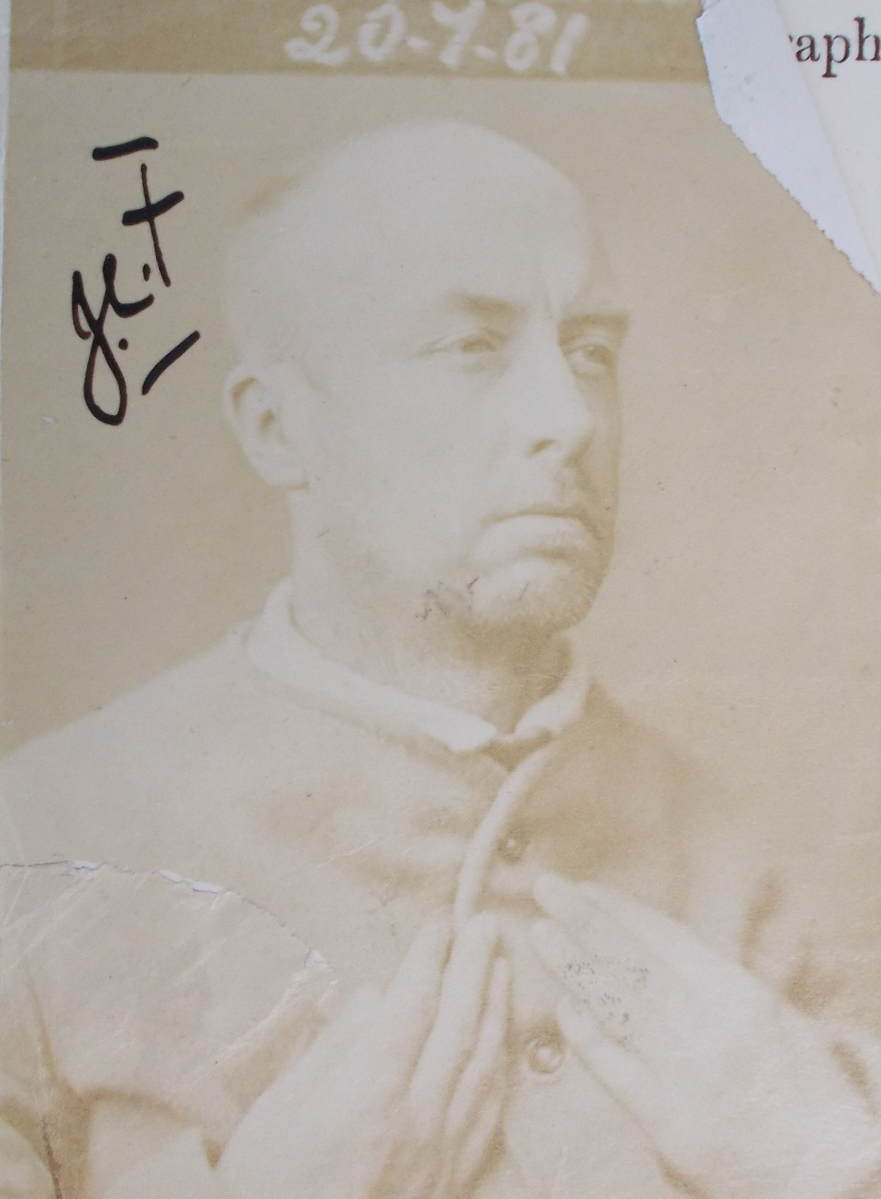
Henry Wilshin
Alias
Captain Willshire,
Captain Henry Grantley,
Henry Gray,
the Hon. Charles Festie,
Harley Henry Wiltshire.
H561
Bigamy, forgery, perjury, fraud.
Portland, 1881
Henry was at “…the point where the gentleman ends and the habitual criminal begins”.
Notes:
The photo presents him a hardened convict. When this was taken he was 38 and starting his fourth prison sentence. An advantage of the prison records is the detail is gives. All his aliases are given here, which facilitates discovering his exploits. By the time he was nearing the end of this sentence, the prison governor was describing him as no longer a gentleman but now a hardened criminal, a member of the criminal classes.

Slide 5
Court cases
1865 Case in chancery to dissolve a partnership.
Prosecuted for fraudulent bill of exchange: acquitted.
Brother Francis prosecuted for fraud: acquitted.
1868 Bigamy, five years.
Divorced.
1873 Witness in the case of Miss Warren and her page.
1875 Divorced.
1876 Non-payment of alimony, six months
1877 Acquitted of forgery
Convicted of perjury, false use of an affidavit, eighteen months
1881 Convicted of bigamy: overturned by Queen’s Bench
Convicted of forgery, five years: fraudulently sold the house of a widow, Mrs Fletcher.
1886 Divorced his wife: decree overturned 1887
Gaol
1868 5 years
1876 6 months
1877 18 months
1881 5 years
Notes:
Here are the court cases in which I found him. He was in the Old Bailey, the magistrates’ court, Chancery, Divorce courts, Queen’s Bench, he was defendant, witness and prosecutor.
Remember that divorce was new: Matrimonial Causes act, 1857.
He was acquitted of fraud, but all his convictions relate to women. His last sentence was for stealing from his emplower, a solicitor, but the case involved a fraud committed against a widow.

Slide 6
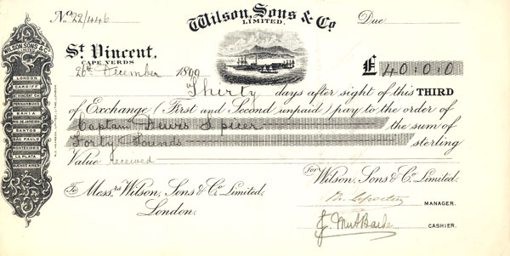
A bill of exchange
£174.4s. London, September 7th 1864
Four months after date pay to my order the sum of one hundred and seventy four pounds four shillings value received.
To Mr Hy. Gray
22 Leadenhall Street.
Charles Wix and Sons
Notes:
Wilshin made his living as a solicitor, accountant, secretary to limited companies and a bill discounter.
This is what a bill of exchange looked like, and this is a transcription of a bill written by Wilshin when he was working with the wine merchant Partridge. The bill is phoney, but it says that Charles Wix and co will pay Henry Gray £174 next January. Gray would hold the bill and present it for payment on the due date.

Slide 7
Transcription of a bill.
Edward Partridge discovered this, screwed up in Wilshin’s office.
£174.4s. London, September 7th 1864
Four months after date pay to my order the sum of one hundred and seventy four pounds four shillings value received.
To Mr Hy. Gray
22 Leadenhall Street.
Charles Wix and Sons
Henry Gray:
a Wilshin alias.
Charles Wix: the original name of the company before Wilshin and Partridge entered into a partnership run the business.
Notes:
The bill was phony. Partridge discovered it screwed up in Wilshin’s office. This one was never discounted, but others were.

Slide 8
Bills fraudulently handled by Wilshin
18th February 1865
Edward Partridge was presented with three bills, payable by Roger K Tulle (untraceable) discounted by Henry Wilshin of Partridge and Co. Total, £1000
23rd February 1865
Edward Partridge was presented with two bills, payable by Charles Wicks and Sons, payable to William Nicholls (Henry’s uncle) endorsed by Henry Wilshin, discounted by Mr Binge, a personal friend of Wilshin. Total, £1000.
27th April 1865
John Joseph Brown was left holding a bill for £190. The bill was payable by George Preece of Westminster, endorsed by W.D.Preece of Southampton and by Wilshin, who had discounted it to Brown in March for £185. George Preece could prove it was not his bill, W.D.Preece was untraceable.
18th September 1865
Wilshin tried for forgery: acquitted.
Notes:
Wilshin was using phony bills. The first set have been discounted by Wilshin on behalf of Partridge, so the bill holder when he can’t get the money from Tulle comes back to Partridge for payment.
The second set are presented to Partridge for payment. Henry’s uncle passed the bill to Binge who discounted it and is now presenting it to Partridge.These bills did not result in Wilshin’s prosecution. Partridge was in the court of Chancery seeking to terminate his partnership with Wishin. Wilshin argued that his actions were reasonable because he was a partner in the company and had invested £1000 in the business.
JJBrown prosecuted Wilshin. Evidence was brought to show that Preece of Soton was fictitious. Wilshin claimed that WDPreece had died on the day the bill fell due. He was acquitted of fraud, but was still liable to settle the bill. His older brother paid off the bill and settled the account with Wilshin’s solicitor. This brotherl;y act resulted in court case some years later.

Slide 9
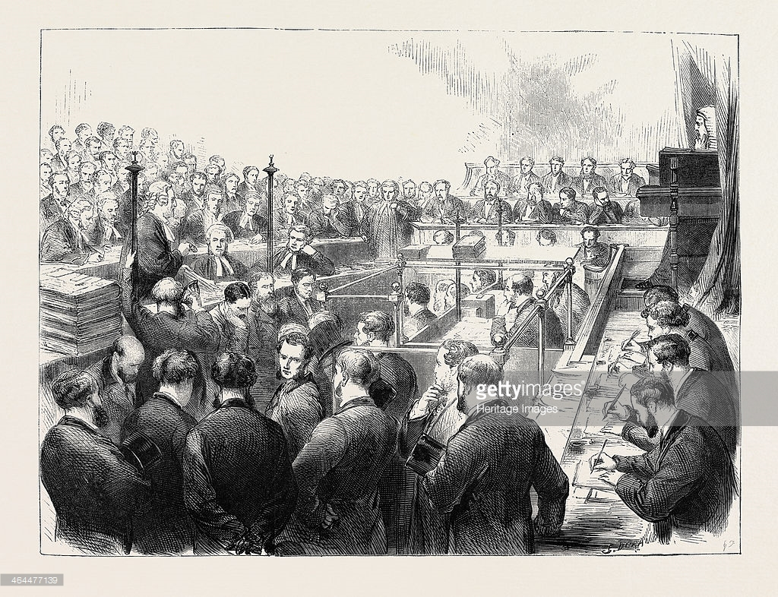
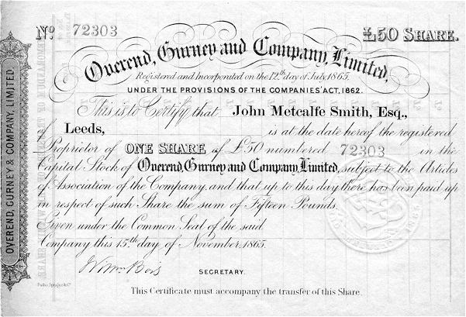
Losses: £11 million
Overend and Gurney, London’s leading discount house, collapsed in 1866.
The directors were brought to trial for fraud in 1869. Acquitted.
Elliott, G., (2006) The Mystery of Overend and Gurney: a Financial Scandal in Victorian England.
Notes:
Discounting bills was common practice in the mid-century, but it was fraught with danger. The prestigious and very large discount house of O and G collapsed with massive debts in 1866. They had been propping themselves up for some years with spurious bills. A private prosecution was brought by some of the casualties of this collapse but it failed: the judge and jury simply could not understand the financial complexities. Wilshin’s grandmother was a Gurney.

Slide 10
Henry married
Ellen Earle (20)
1864
Worth £578
Ellen filed for divorce, 1868.
Henry
“Captain Henry Grantley”
married
Ada Leslie, age 17
Worth £2000
1868
5 years for bigamy
Engaged to Alice Gregory, 1876
Broken off when Henry was in court for fraud
1877
Henry
married
Emily Marshall
Worth £10000
1874
Henry forged an affidavit claiming her father gave permission for her to marry.
Emily filed for divorce 1875
6 months, non-payment of alimony
Married Edith Mary Miller
1880
Convicted of bigamy, but conviction over-turned at Queen’s Bench.
1881
Harley Henry Wiltshire (29) married Charlotte Lavers, age 20
1879
Charlotte moved in with another man while Henry was in gaol.
1886
Henry filed for divorce, decree nisi granted.
1887
Decree overturned by Queen’s Proctor.
Marriage, bigamy and divorce
Notes:
Wilshin also was very active matrimonially. The women he married were under age and rich, and with fathers who were missing. Two of his marriages were bigamous, three ended in divorce.

Slide 11
“Captain Henry Grantley” married Ada Mary Leslie, aged 17.
Daughter of Sir Norman Leslie, bart, of the Bengal Lancers, “the first British officer who was killed the Indian mutiny”
Worth £2000
1868
5 years for bigamy
Major Henry Grantley, The Last Chronicle of Barset, Anthony Trollope, 1867
After service as a major in India, where he received the Victoria Cross, fell in love with Grace Crawley and, overcoming all objections, married her.
Notes:
This is one of his bigamous marriages in more detail.

Slide 12
Letter from Henry to his wife Lottie, 19th February 1884
…..the infamous report that that woman Marshall had inserted, and only a few days ago something was said to me that implied I never worked outside; you know well enough how hard I did work in my profession; …. I now see how differently it would have been if I had had my own way at the ‘trial’… My university education is accounted a crime against me and you at least ought to have had some feeling for me …
Notes:
Henry had received a letter from Lottie telling him that she never wanted to see him again. She did not mention that she had been living with another man for some years now. Henry’s reply is interesting for how he asserts his upper class status and respectability. Hard work and education, and how unfairly he has been treated.

Slide 13
13-5-1884 Letter from Robert Goring
“To Sir Edmund Du Cane From Berkeley Square
…this unfortunate man was and I believe still is a gentleman highly educated and refined. His conduct under discipline is irreproachable. He has not lost a single mark of remission but he appears to be unable to get any of the advantages which appear to be reserved for habitual criminals…”
Notes:
Henry frequently complained of poor treatment in gaol. He was under-fed, made to do hard manual labour, not allowed to do work suitable for a man of his station. Despite the strictures of prison discipline, he managed to get a message to his friend Goring, who then took up his case with the director of convict prisons. Du cane wrote immediately to the governor of Portland prison, ordering him to report back on Wilshin’s case.

Slide 14
“inasmuch as he is now undergoing a second sentence of penal servitude …. he would appear to be rapidly approaching … the point where the gentleman ends and the habitual criminal begins…. the statement [in Goring’s letter] that there have been about 20 preventable deaths since Dr Lilley has been appointed may be taken as a gauge of the truth of other portions of his letter.”
Notes:
The governor’s report was lengthy, rebutting point by point everything that had been in Goring’s letter.

Slide 15
Conclusion
Wilshin got away with fraud. His male victims had little recourse against him.
He was convicted of crimes against women, crimes that threatened the social structure.
Wilshin framed his sense of grievance by seeing himself as a victim who was denied the status due to one of his class.

