Slide 1
Chorionic and amniotic placental membrane-derived stem cells, from gestational diabetic women, have distinct insulin secreting cell differentiation capacities
Supporting information

Slide 2
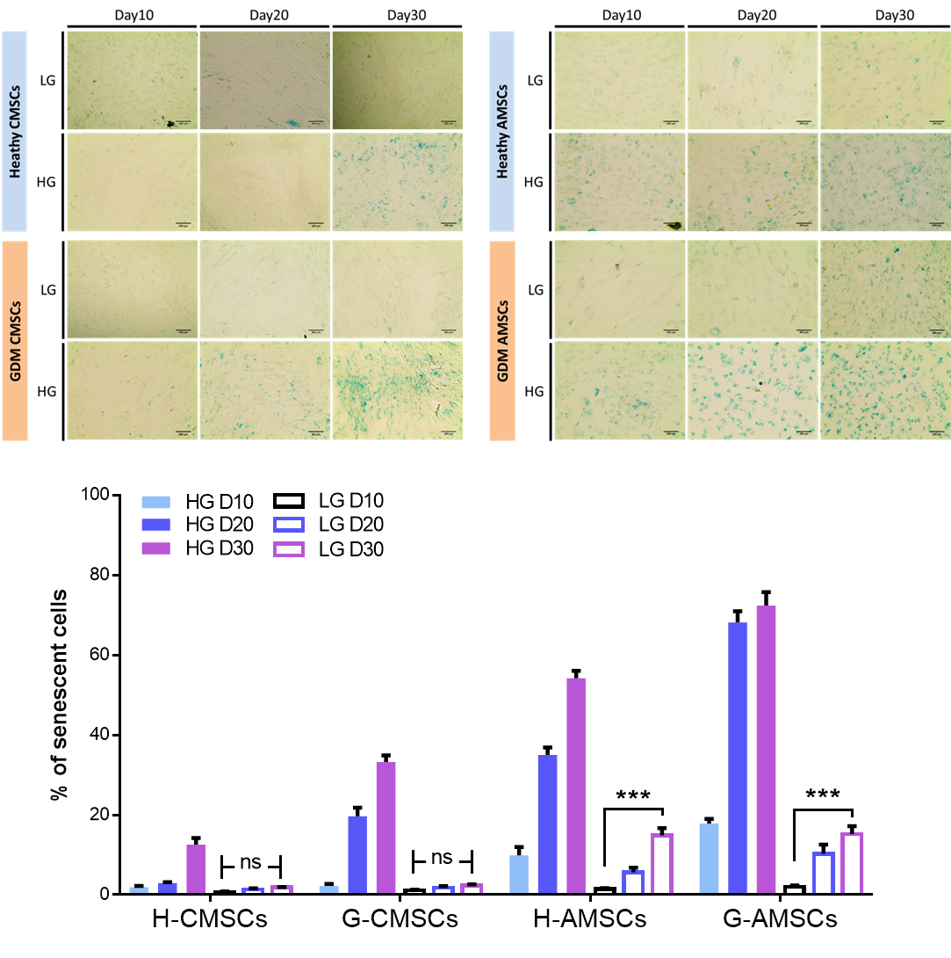
Figure S1. The staining of senescence-associated-beta-galactosidase (SA-β-Gal) activity in HG and LG culture. The effect of HG on cellular senescence was measured by SA-β-Gal activity. In H-/G- CMSCs, no cellular senescence was detected in LG culture during a 30-day period. In H-/G- AMSCs, senescence was detected in both LG and HG culture. Significantly increased SA-β-Gal activity was observed in LG-D30 vs LG-D10 in both H-AMSCs and G-AMSCs.

Slide 3
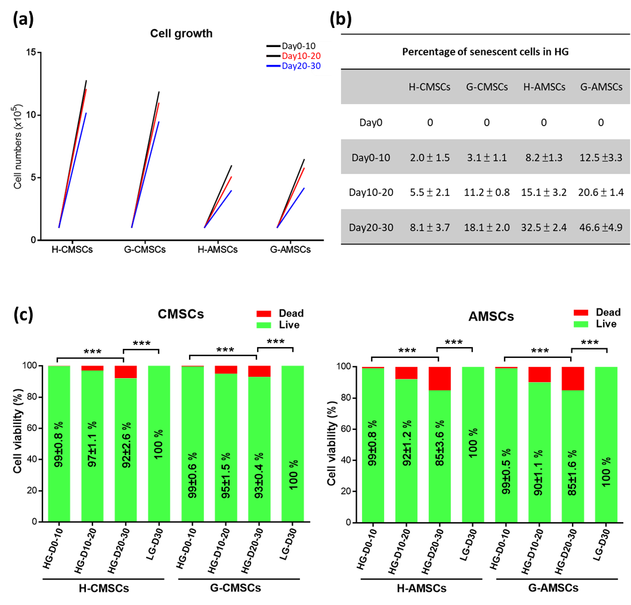
Figure S2. The cell growth, senescence, and cell death in HG culture. To eliminate the possibility that cell senescence and death observed in HG culture was the result of cell over-confluence, cells seeded at the number of 1x10⁵ on day0, passaged and reseeded at the same number on day 10 and 20. The increase of cell numbers was examined by cell count, cell viability and senescence on day 10, 20, 30 were determined by calcein-AM/EthD-1 and SA-β-Gal activity, respectively. (a) The proliferation of H-/G-CMSCs/AMSCs was reduced in day10-20 and day20-30 compared day0-10. (b) Cell senescence was increased in H-/G- CMSCs and AMSCs while G-CMSCs/AMSCs showed higher increasing rate than H-CMSCs/AMSCs. (c) Cell viability was decreased in H-/G-CMSCs/AMSCs under HG culture. Data are shown mean ± SD from 3 independent experiment.

Slide 4
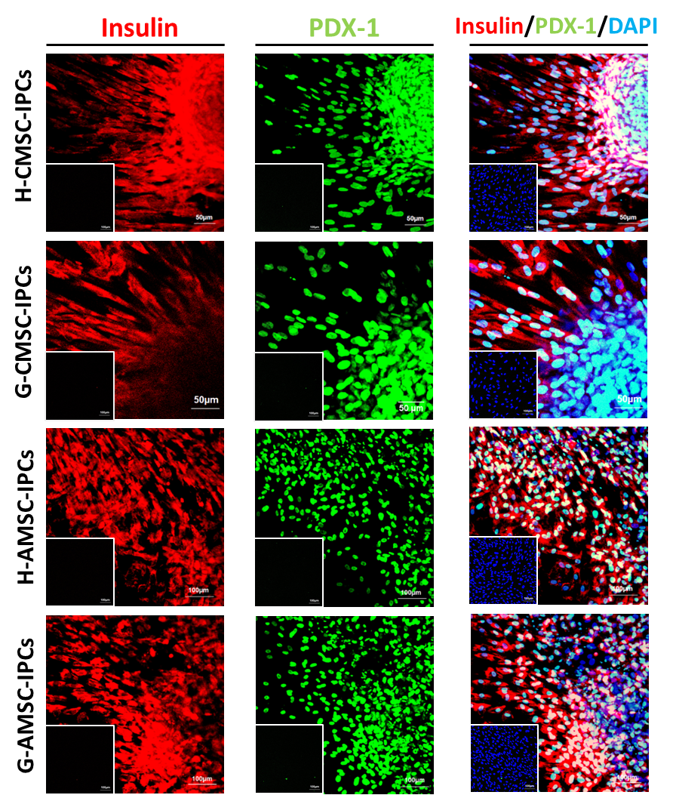
Figure S3. Immunofluorescent staining of insulin and PDX-1 co-expression. Confocal images of H-/G- CMSCs and AMSCs derived IPCs showed co-expression of insulin (red) and PDX1 (green). DAPI was used as nuclear counterstain in blue. (scale bar, 100 μm). Undifferentiated H-/G- CMSCs and ASMCs staining image of insulin and PDX-1 expression showed at the bottom left corner.

Slide 5
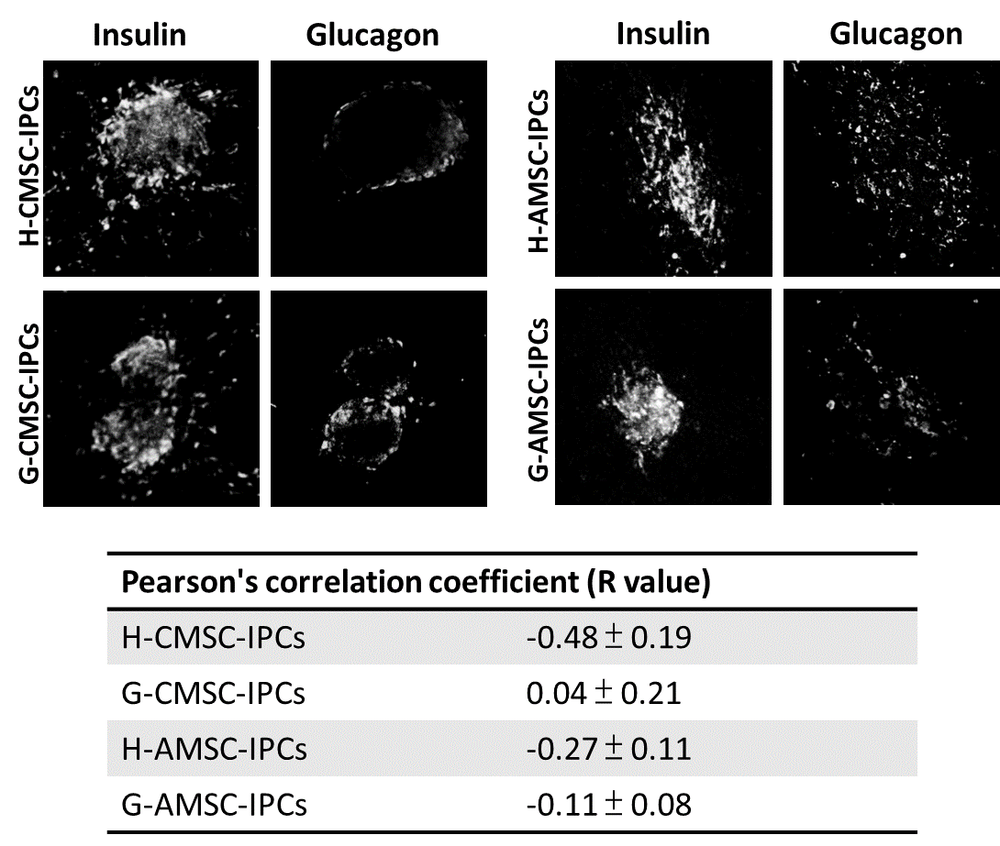
Figure S4. The co-localisation of insulin and glucagon analysed by Pearson correlation coefficient (R). The R value calculated by Image J Coloc2 plugin, ranges from +1 (perfect correlation) to -1 (anti-correlation) and 0 indicates no correlation.

Slide 6
Table S1. Minimal criteria for defining MSCs suggested by The International Society for Cellular Therapy
CD makers | Catalogue no. | Isotype control
CD19 (-) | 130-098-168 | IgG1 (130-098-845)
CD90 (+) | 130-098-906
CD73 (+) | 130-097-932
CD105 (+) | 130-098-845
CD14 (-) | 130-098-167 | IgG2a (130-098-849)
CD34 (-) | 130-098-140
CD45 (-) | 130-098-141
HLA-DR | 130-098-177
All antibodies were phycoerythrin (PE) conjugated and according to the manufacturer’s recommended volume, antibodies were diluted at 1:50. All antibody were purchased from Miltenyi Biotec, Germany.

Slide 7
Table S2. Primers used for real-time PCR
Genes | Forward Primer (5’-3’) | Reverse Primer (5’-3’)
GAPDH | ACTTCAACAGCACACCCACT | GCCAAATTCGTTGTCATACCAG
GLUT2 | TGCCCACAATCTCATACTCAA | TACAGACAGGGACCAGAGCAT
GCG (glucagon) | CTCTTCACCTGCTCTGTTCTAC | TGGATTTCTCCTCTGTGTCTTG
INS | GCAGCCTTTGTGAACCAACA | TTCCCCGCACACTAGGTAGAGA
ISL1 | CAACTGGTCAATTTTTCAGAAGGA | TTGAGAGGACATTGATGCTACTTCAC
NANOG | CCCAGCCTTTACTCTTCCTACCAC | GATTCCTCTCCACAGTTATAGAAGGGA
NEUROG3 | CTATTCTTTTGCGCCGGTAGA | CTCACGGGTCACTTGGACAGT
OCT4 | GTCCGAGTGTGGTTCTGTA | CTCAGTTTGAATGCATGGGA
PAX6 | TGTCCAACGGATGTGTGAGTA | TCCCGCTTATACTGGGCTATT
PDX1 | TTCCGGAAGAAAAAGAGCCA | AAACAGGTCCCAAGGTGGAGT
SOX2 | CCATCCACACTCACGCAAA | GCAAAGCTCCTACCGTACCACT

Slide 8
Table S3. The expression of CD makers in H-/G- CMSCs/AMSCs
Percentage of CD marker expression (Mean ± SEM, n=7)
CD markers | H-CMSCs | G-CMSCs | H-AMSCs | G-AMSCs
CD73 | 98.9 ± 0.02 | 98.7 ± 0.2 | 95.3 ± 2.2 | 97.7 ± 0.2
CD90 | 88.0 ± 3.5 | 86.2 ± 3.3 | 92.3 ±3.7 | 96.2 ±1.6
CD105 | 98.2 ± 0.8 | 98.6 ± 0.4 | 86.3 ± 4.0 | 85.3 ± 0.8
CD19 | 1.5 ± 0.4 | 1.7 ± 0.2 | 2.0 ± 0.4 | 2.0 ±1.4
CD14 | 1.7 ± 0.4 | 2.0 ± 0.5 | 1.9 ± 0.8 | 1.6 ± 0.3
CD34 | 2.1 ± 0.6 | 2.6 ± 1.4 | 2.0 ± 1.6 | 2.8 ± 0.6
CD45 | 3.6 ± 1.0 | 7.7 ± 1.6 | 2.9 ± 2.1 | 9.5 ± 2.0
HLA-DR | 2.0 ± 0.1 | 1.6 ± 0.1 | 2.0 ± 0.7 | 2.6 ± 0.7

