Slide 1
Assessing Research Grants in the Era of the COVID-19 Pandemic
Dr Andrew England
Senior Lecturer in Radiography
a.england@keele.ac.uk

Slide 2
About Me
Dr Andrew England
Senior Lecturer in Radiography
Academic
Clinical Radiographer (20 years)
Chair – EFRS Educational Wing
2 children
1 dog

Slide 3
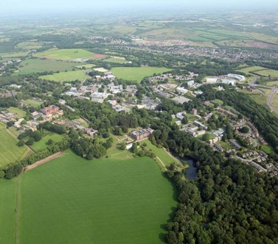
Keele University
A ‘village’ …..
Top 3 UK – student satisfaction
‘GOLD’ in Teaching (TEF)
97% research world-leading / internationally important
96% graduates get jobs

Slide 4
Twitter
Facebook
Linkedin
Email – a.england@keele.ac.uk

