Slide 1
“In The Same Room” - practical methods to encourage collaboration across scientific disciplines
Mark E. Smith - Research Institute Manager Alicia J. El Haj - Professor of Cell Engineering
ISTM, Faculty of Health, Keele University
www.keele.ac.uk/istm
Institute for Science & Technology in Medicine,
Keele University, Guy Hilton Research Centre,
Thornburrow Drive, Hartshill, Stoke-on-Trent ST4 7QB UK

Slide 2
Overview
Gaps to be bridged: disciplines, departments, culture, geography
Bridging the Gaps: Modelling Methods for Medical Engineering (3ME)
Practical methods to encourage collaboration
… what worked and what didn’t

Slide 3
Keele: multi-disciplinary since it was founded in 1949
A campus-based university with dual-honours degrees and research in science, social science and humanities. PG Medicine courses from mid 1970s

Slide 4
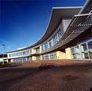
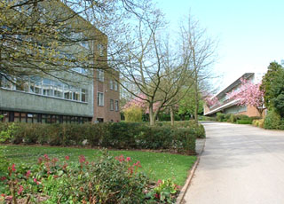
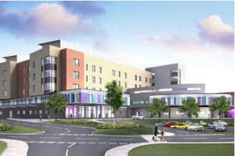
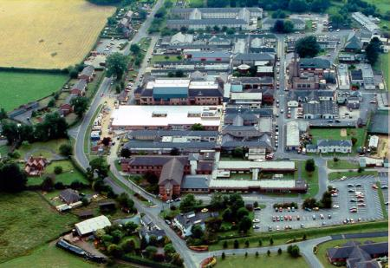
Research Institute for Science & Technology in Medicine (ISTM)
A multidisciplinary Institute formed to underpin the new Medical School between Keele and Manchester.
Keele Medical School
Brings together dispersed clinical and laboratory-based researchers from different departments and cultures.
School of Life Sciences
University Hospital of North Staffordshire
(PFI development)
Guy Hilton Research Centre
RJ&AH Orthopaedic Hospital

Slide 5
In the same room?
A BBSRC/EPSRC/MRC-funded stem cell project in 2005, led by Prof Alicia El Haj and involving Keele mathematicians, had already shown that collaborative approaches could extend research capabilities to address major biomedical questions.
There were state-of-the-art modelling and imaging techniques being developed in other fields at Keele that were very valuable to current biomedical projects. How could the groups be brought together?

Slide 6
“Bridging the Gaps”
“Bridging the Gaps” programme (BtG) was set up to build a cross-disciplinary culture in UK universities, and in particular to encourage very novel research ideas at the boundaries of traditional disciplines whose members would never normally meet. Initially BtG funding focussed on IT based collaborations, the second and third calls for proposals gradually broadening the remit.
Review of BtG: McNeill H (2010) Evaluation of the Engineering & Physical Sciences (EPSRC) Bridging the Gaps Scheme: EPSRC

Slide 7
An unusual combination
An idea was drawn up initially between Keele’s biomedical researchers and applied mathematicians. It fitted well with the objectives EPSRC had set for BtG and also matched the common submission of several members of the groups to RAE2008: Modelling Methods for Medical Engineering.
Modelling techniques used by Keele’s geophysicists were then added, and the project presented around clinical and industrial needs in biomed engineering.

Slide 8
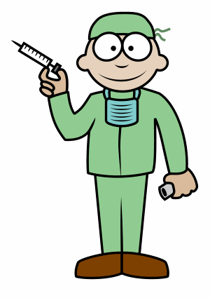
The initial collaboration
The 3ME Initiative brought together 4 different discipline groups: - biomedical engineers - applied mathematicians - geophysicists - clincians

Slide 9
Keele’s EPSRC BtG grant
The 3ME Initiative won its grant in the second BtG round, funded from April 2008 - July 2011.
Although it was one of the smaller scale awards, its members also took an active part in the shaping and evaluating the national programme.

Slide 10
Mechanisms used for 3ME
Various mechanisms were proposed by the 3ME Initiative, some were novel and untried.
The key aim was to enable researchers to meet and discuss current challenges for their research programme.
This involved in many cases learning a new language and understanding practices within certain disciplines.

Slide 11
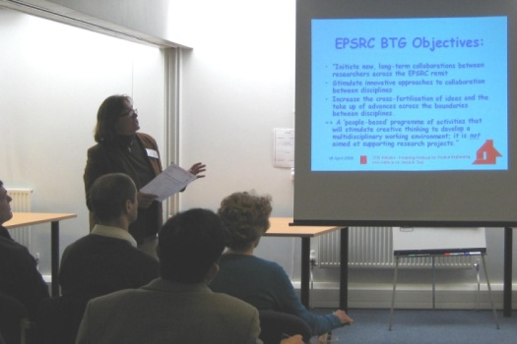
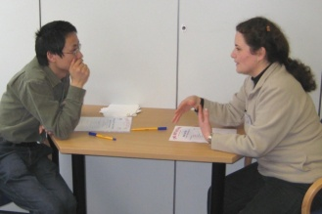
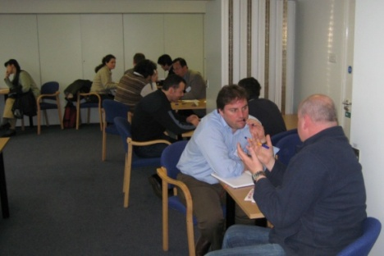
Key Mechanisms
After an Opening 3ME Meeting in March 2008 to make first contacts between academics, we tried:
Researchers in Residence
Sandpits, Research Retreats
Pilot Projects
Back-to-Back Seminars
30 participants, exotic food and “Speed dating”

Slide 12
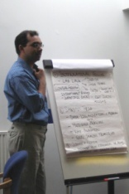
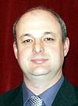
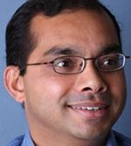
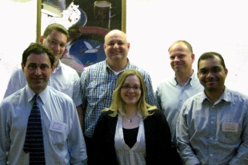
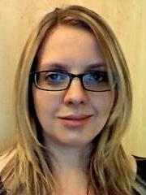
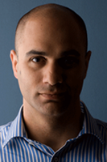
Researchers in Residence
“Staff swap roles to immerse themselves in a new research culture.”
Created 4 RinR posts in 2008-11, +1 in 2011-12
Average £4,000 per full-time month.
Particular benefit to early career researchers.
Dr Serguei Annenkov
Dr Shailesh Naire
Dr Nigel Cassidy
Dr Sarah Griffiths
Dr Theo Kyriacou

Slide 13
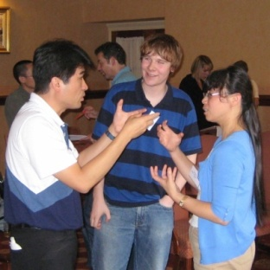
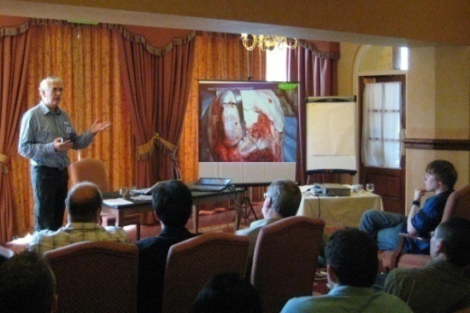
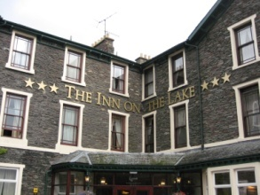
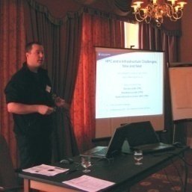
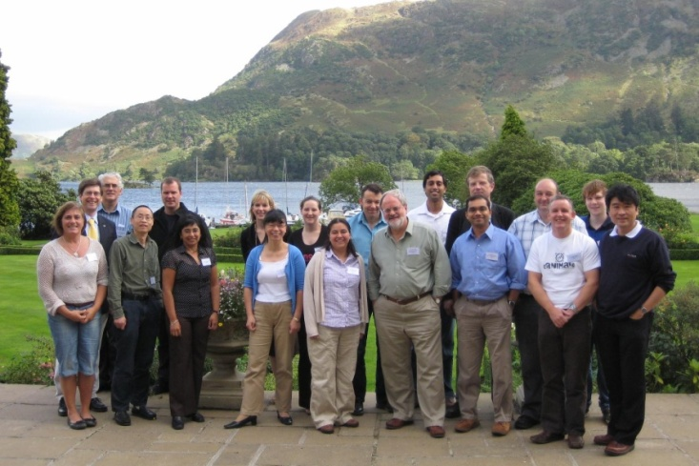
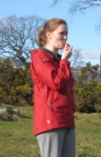
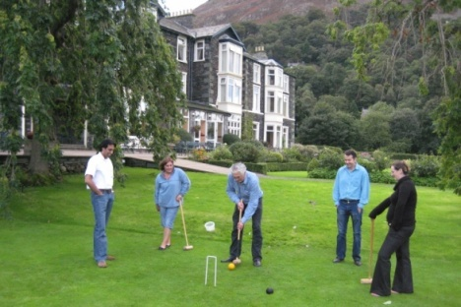
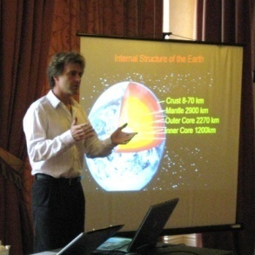
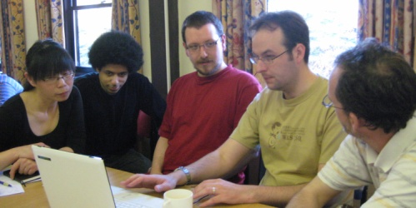
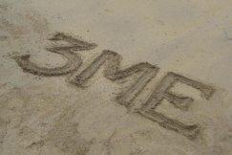
Sandpits, Research Retreats
Sept 2008 & ‘09, Feb ’10, July ‘11 – 3 days each
Staff, students, clinicians, industry in the room
Isolated hotel, visiting speakers, breakouts.

Slide 14
Pilot projects
Awarded through participation in sandpits
Multi-disciplinary, involving 3ME participants
Allocated through a
15-20 pump-primed projects, average £5,000.

Slide 15
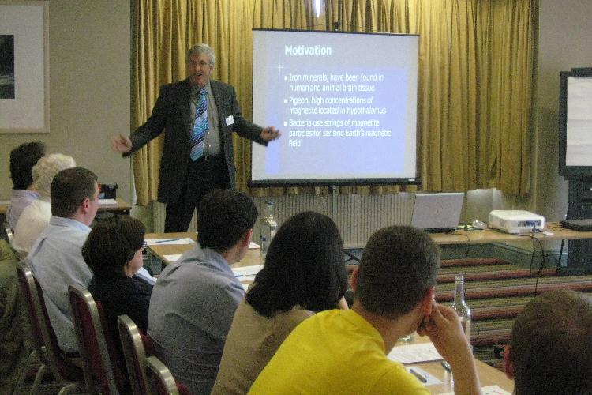
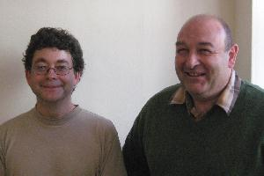
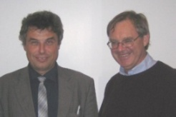
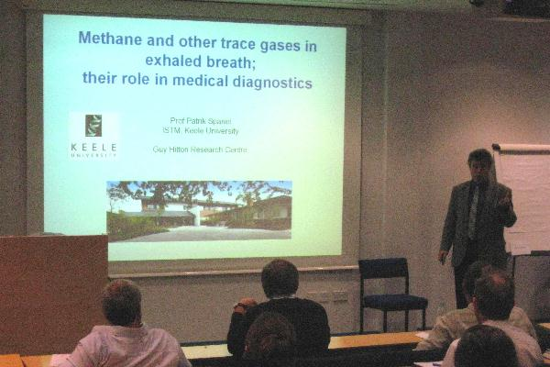
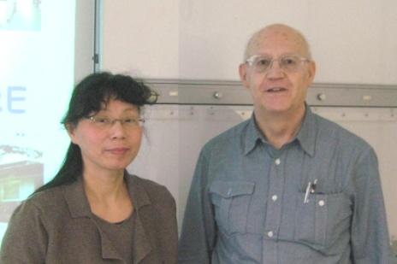
“Back to Back” Seminars
A single subject or problem tackled in two 40 minute talks by researchers from different disciplines, followed by extended discussion. eg
Prof Patrik Spanel (Keele/Prague) : Methane as a diagnostic in the breath of patients
Prof Euan Nisbet (Royal Holloway) : ‘Atmospheric methane – the quiet giant’

Slide 16
Shaping the 3ME Initiative
The role of the 3ME Initiative Steering Group in designing the funded activities, reflecting on their success and responding to changing demand was crucial.
Not all mechanisms put forward in the original proposal to EPSRC proved to be successful, eg an online industry forum was not implemented.

Slide 17
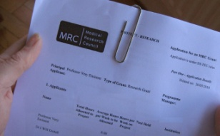
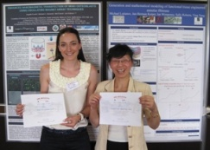
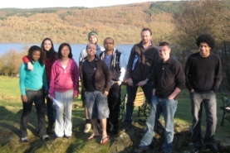
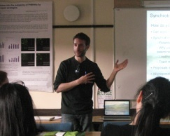
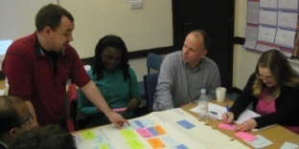
The positive outcomes
Achievements: publications, grants, personal links
Longer term positive effects: new Keele-based interdisciplinary activities, now expanded to cover Humanities & Social Sciences for a further year, with additional EPSRC and MRC funds. Eg. Keele Law and Ethics groups in a network lunch meeting with Human Biomedical/ Regenerative Medicine.

Slide 18
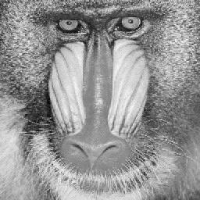
Sandpit Project … ‘FACE’
Fractal analysis
in clinical cell therapies
Start
Collaboration between
Orthopaedics, Computer Science and Geophysics
- a 6 week funded project
End

Slide 19
Sandpit project… Cell behaviour analysis ex. Guiding cells using fibres
Follow on collaborations with industry – Cell IQ

Slide 20
Researcher in Residence…
Nigel Cassidy
Finite-difference modelling used for the design of electrical stimuli in bio-reactors
A geophysicist discipline hopping into the tissue engineering arena.
Utilising his electromagnetic modelling skills for research into cell stimulation in bio-reactors.
“a valuable and unique opportunity to experience and develop research in a new discipline – extremely rewarding and very enjoyable”
Finite-element modelling of NdFeB magnetic array elements.

Slide 21
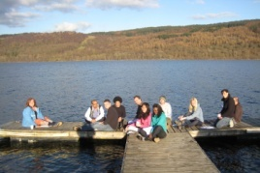
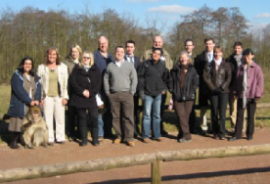
Connectivity to new grants
EPSRC Doctoral Training Centre in Reg Med
- PhD summer school: first year 6 week projects
EPSRC “Creativity@Home” scheme workshop
BBSRC Modular Training for Industry Programme
Links to EU FP7 IRSES exchange programmes with China and Network of Excellence EXPERTISSUES
EPSRC Centre in Manufacturing of Regenerative Medicine – Metrology.

Slide 22
Thank you for listening
Acknowledgements:
3ME Steering Group: Prof Alicia El Haj, Prof Jon Dobson, Prof Peter Styles Prof Graham Rogerson (the 4 Co-investigators), Mark Smith, Pauline Weston.
Researchers in Residence and the sandpit participants
Facilitators, support staff: Paula Marsh, Maria Kyriacou
Funders: EPSRC, Keele, MRC
Our BtG website: http://www.keele.ac.uk/bridging-the-gaps

