Slide 1
Identity Concealed or Revealed? The use of photography in the Victorian criminal justice system
Dr Guy Woolnough
School of Criminology and Sociology
Keele University
g.woolnough@keele.ac.uk
@GuyWoolnough
Notes:
This paper examines the use of photography by the police, courts and prisons in the later 19th century. There was a general fear that hardened criminals would move from place to place, assuming new identities in order to pass unnoticed. If caught they would escape with lenient sentences because they could claim to be first time offenders. Photographs seemed to be an excellent technological solution to the problem, but it will be clear that in practice they were very inadequate for that purpose.

Slide 2
Biber “Society invests the image with meaning and power.”
The villain “is recognised, dragged into the spotlight for a moment, before disappearing again into prison”
Carney: the photo applies a mark to the body that shames, humiliates and fascinates.
Foucault, The important question is not what power is, but who exercises it.
Kathryn Biber, ‘The Spectre of Crime: photography, law and ethics’,
Phil Carney, ‘Crime, Punishment and the force of photographic spectacle’
Michel Foucault, Politics, Philosophy, Culture: interviews and other writings, 1977-1984,
Notes:
The photograph is very limited when interpreted from a functional perspective, but far more interesting if used to test theories of power. Biber has described the photo as an agent of repression, and said that the image is both frightening and reassuring: the convict looks menacing, but is now safely caught in the photo and locked away in gaol. Biber wrote “Society invests the image with meaning and power.” This links neatly with Foucault, who observed that the important question is not what power is, but who exercises it. This paper will bear out Foucault’s observation that it is not necessarily those who govern who hold power.

Slide 3
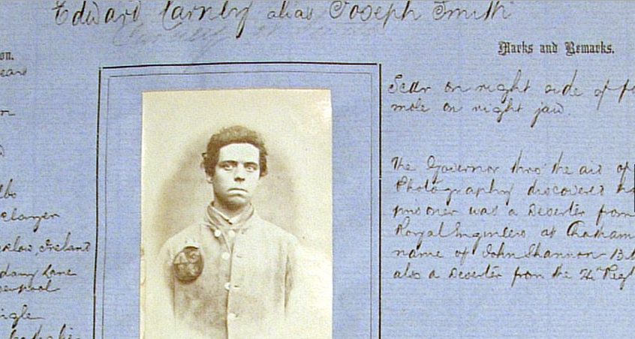
Edward Carney, Bedford Gaol, 1865.
Photographed by Governor Robert Evans Roberts
The Governor has thro’ the aid of photography discovered that this prisoner was a deserter from the Royal Engineers at Chatham
Notes:
Photography came into the Criminal Justice System in a bottom-up way. Photos were not used following a directive from Whitehall, but because individuals in the provinces started to experiment with their cameras. The first known use of the photo to record prisoners was in Bedford and Bristol gaols, where governors whose hobby was photography applied their cameras to recording the inmates. The textual detail of the type seen on this record was not new. Written descriptions of convicts had been kept for many years. You will notice that on this record the governor claims that the photo made it possible to discover Carney’s previous offences, but in fact there were very few examples of the successful of photos in identifying offenders. The number of photos collected and stored centrally increased rapidly, but the written description, of offender and offences, remained more effective, and was backed up by the practice of long-service police or prison officers checking the men in custody to see if they could recognise any.

Slide 4
Cumbria Archives, Kendal Record Office, WS Cons 10/2
Notes:
Because I am interested in police practice at the grass routes, I have used local police records. There are many record books like this in Archives across England. What they reveal is how the police worked. Kendal is and was a small town with just 14 police in the 1880s. As a borough force, they were independent and made their own decisions on how to organise their work.

Slide 5
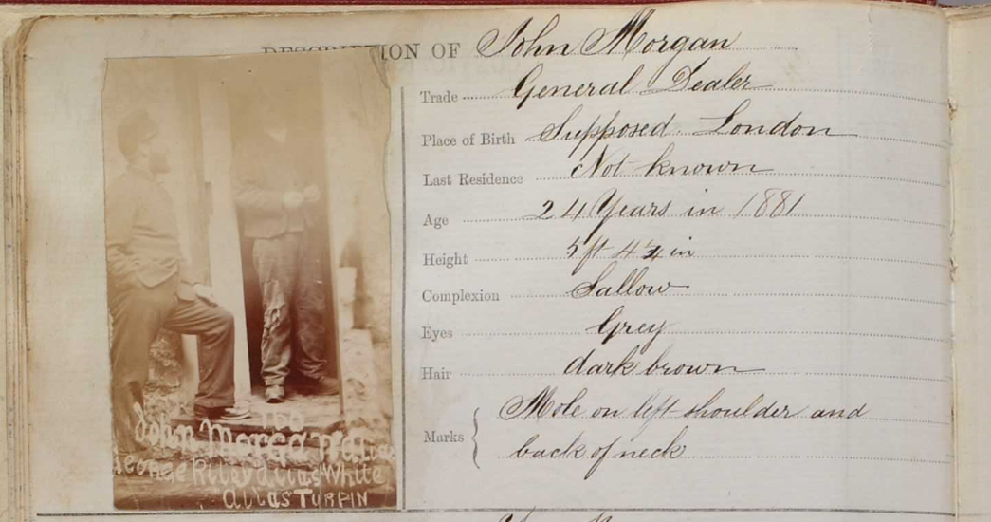
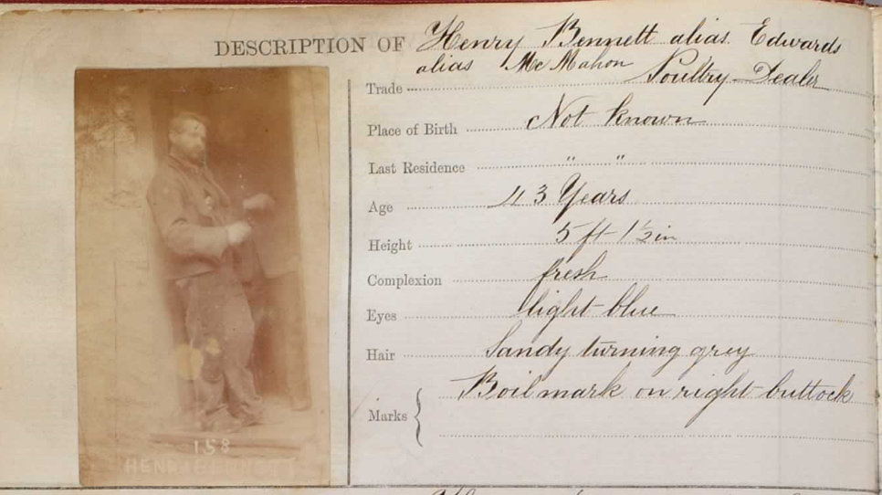
Kendal Police
Photo book
The first entries, photos taken in Kendal Gaol, 1881.
Notes:
The first entries in the Kendal book show the limitations of police competence in using this new technology. They did employ a local photographer, named Ford, but he was more familiar (I suppose) with studio photography and street scenes, so when he is called down to the police station, the results are very disappointing. No one can have failed to realise that these photos were useless for identification.

Slide 6
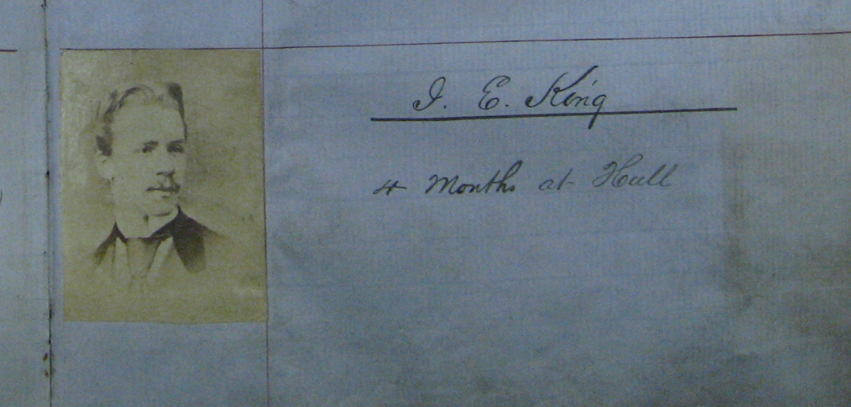
Manchester police Photograph book
(Held at Manchester Police Museum)
1870 or 1871. No date, no context, just a random photo that has come into the hands of Manchester Police
Notes:
I have also used the police photos kept at the Manchester Police Museum. I had expected a big, modern city to be well ahead of Kendal, but was surprised to find entries like this in the early pages. Even when the photos had clearly been taken by a police photographer, the entries were still ludicrously inadequate. For example, three men photographed separately, with the only information in the book: “For trial for burglary at Old Trafford, July 1870”. No names, no descriptions, no detail at all. The practice of using photographs was being worked out locally, in police stations and prisons across Britain.

Slide 7
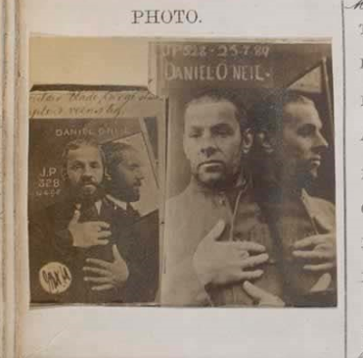
Daniell O’Neill
Kendal
Convicted for stealing a watch, 1893, 5 years’ penal servitude.
Was it the photo that identified him, or his missing finger?
Notes:
Systems did improve. You can see that this photo has been made using a mirror to show the prisoner’s profile. We see here a strategy of power, the prisoner co-erced and manipulated to present the right view of him, marking the man as an offender. It is clearly not a studio portrait. These are photos that were sent to Kendal from elsewhere.

Slide 8
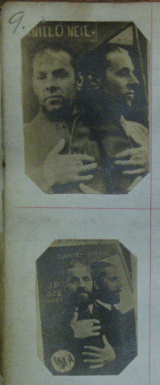
Daniell O’Neill
Same photos in two police photo books
Manchester
Entry c1881
“Has been convicted of theft and fraud at Glasgow, Edinburgh, Carlisle, Preston, Appleby and many other places. Has also been in a number of lunatic asylums.”
Notes:
I explored the Manchester photo books to find villains who were also in the Kendal book, but only one turned up in both books. O’Neill was a highly itinerant offender, but was he recognised from the photo or from his missing finger? Notice the presentation of the hands upon the chest. This is a feature that arrives in the photos from the early 1880s. This photo was taken soon after Bertillon developed his anthropometric system in France. Bertillon realised that although the face might change over the years, the dimensions of the limbs and digits do not. The Bertillon method might be reflected in the positioning of the hands, though it was not until 1893 that the Home Office considered the Bertillon system and rejected it as too costly. I have found no order (from a chief constable, from the Home Office or anyone in authority) requiring offenders to place hands upon chests, but British policemen seem to have been aware of the potential of recognising an offender after many years by the relative lengths of the digits.

Slide 9
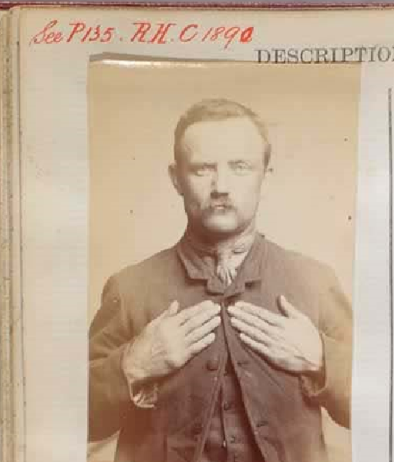
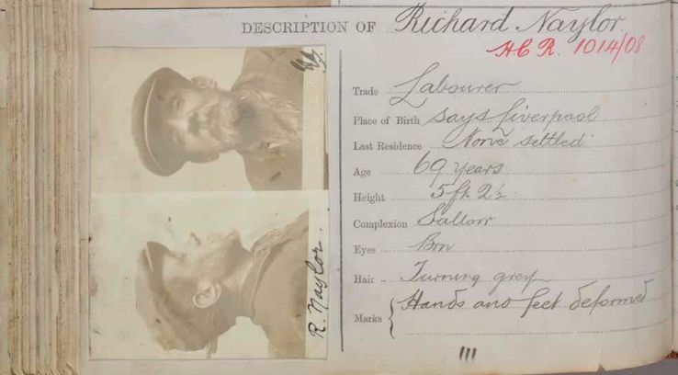
The Habitual Criminals Register
Introduced by statute in 1869
Included photos from 1871
Dennis McBride
Convicted at Kendal, felony,
3 years’ penal servitude, 1892
Richard Naylor
Convicted at Chester, felony,
4 months’ Penal Servitude, 1908.
Convicted at Kendal, 1910, 3 months
Notes:
The ending of transportation in the early 1860s created a convict panic: what should be done with these desperate men when they were released from gaol in Britain? The Habitual Criminals Register was initiated by Act of Parliament in 1869. Details of convicts were recorded by Scotland yard, and books listing habitual criminals were distributed to police forces. The books (Now in National archives) were organised according to the offenders’ dates of release. They contained detailed descriptions: tattoos, aliases, convictions, known destination etc. From 1871 photos were collected, but Scotland Yard found these very difficult to file and organise. Virtually no criminals were identified using these mugshots. (Answer by Home Sec to question in Parliament) You can see on these photos the HCR numbers. But the system relied upon Kendal police identifying the offender then requesting a photo. Prisoners were often identified by means of the Police Gazette. Kendal police would advertise that they had caught a person for a certain offence. A detailed description was included, and the offer to supply a photo if requested.

Slide 10
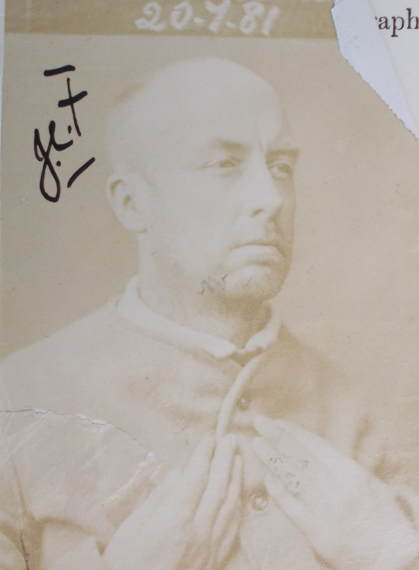
Prison
Photos
H561
Bigamy, forgery, fraud.
Portland, 1881
Notes:
This is a prison photo. These can be found in the prison files at the National Archive. They are taken in much the same way as the police mugshots, except convicts are always in prison clothing, police mugshots usually in normal dress. All the photos bear out Biber’s assertion that the villain is “recognised, dragged into the spotlight for a moment, before disappearing again into prison.” Phil Carney observes that the photo applies a mark to the body that shames, humiliates and fascinates. The man here is interesting because he was a gentleman, rich family, university education, described in the press as good looking, a good singing voice and looked like a dashing cavalry officer with Dundreary whiskers. In this picture he is deprived of everything and reduced to a brute. He looks more like Magwich than a gentleman.

Slide 11
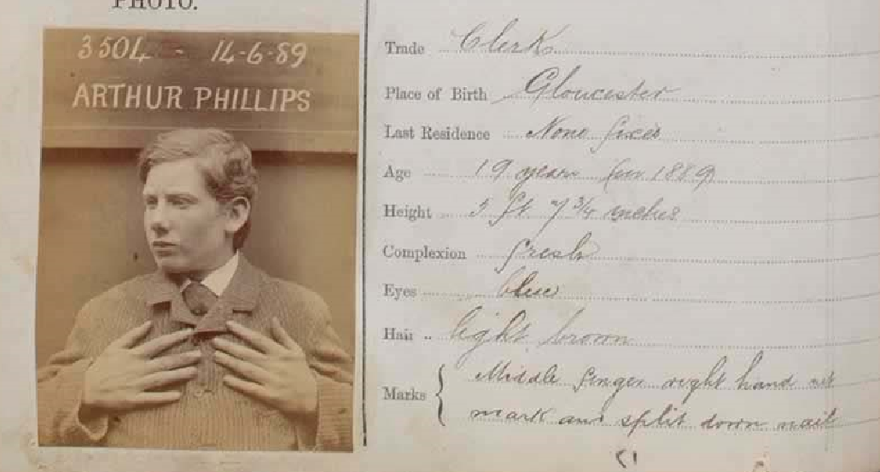
Arthur Phillips, begging in Kendal,
June 1889, 14 days’ hard labour
Photo sent to Gloucester to check Arthur’s identity: was he known to the police there?
Notes:
There was a significant change in the way crime was understood in the 19th century, and the change is exemplified in the case of Phillips. In 1800, the law was only interested in the crime and the penalty: begging=one month. But after mid-century, the criminal himself became part of the equation. Who was he? Why did he do it? Phillips claimed to be a solicitor’s clerk from Gloucester, who had lost his family and his job through no fault of his own. The magistrates heard his sob-story and expressed sympathy. They might have dismissed the case, but ordered the police to contact Gloucester. The date of the photo and his court appearances suggests that this photo was taken in order to send to Gloucester. The police in Gloucester said the name, face and the firm of solicitors were unknown, so Phillips’ story was not supported: Phillips was sentenced to 14 days. The photo is part of the attempt to understand the man, to read and identify him.

Slide 12
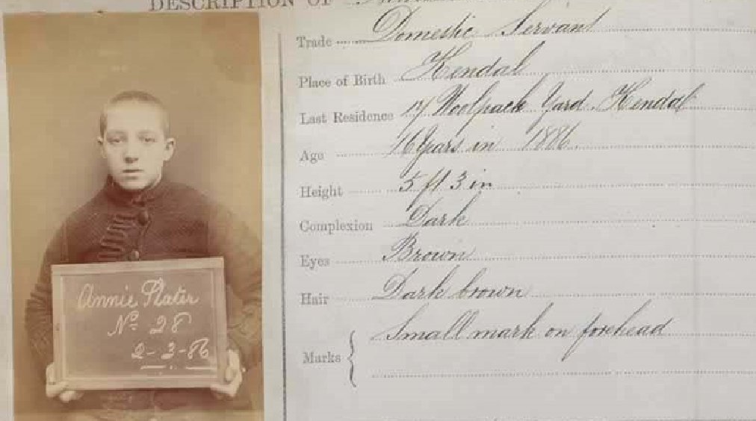
Annie Plater, age 16, theft, Kendal,
February 1886, one month hard labour
Why was this photo taken? Annie was born in Kendal, lived in Kendal. Stealing clothing from her place of work was her first and only recorded offence.
Notes:
There are pictures in the Kendal book which make no sense from a functional point of view. This 16 year old was born, lived and worked in Kendal, where she committed a minor theft. The police in the town would have known who she was, the theft was her first offence, and she was not likely to leave the town. There was no practical reason to take a photo, except to mark Annie as a criminal type. But the photo has the power to shame, humiliate and intimidate. The police can say to Annie “We’ve got you now”. The photo may also have formed part of the police collection of criminal types, echoing the ideas of Lombroso.

Slide 13
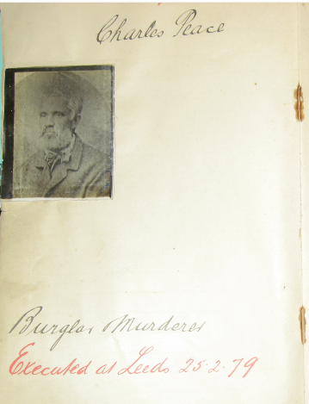
Charles Peace
Burglar. Murderer.
Executed at Leeds 20.2.79
From the Rochdale Police Detectives Photograph book
Notes:
Here is an interesting mugshot from Manchester. Clearly there was no chance of Peace ever coming back to Manchester, but he is certainly a criminal type, and idea that was seriously explored by Lombroso in Italy and Galton in England. The idea they worked on was that criminality would be evident in the physiognomy of the offender, that there were recognisable ‘criminal types’, an idea which fed the professional aspirations of the police. The police could present themselves as the experts who could spot a thief, and the book lent credibility to that claim. Charlie Peace’s photo could also have been included as a trophy, a statement of police success in dealing with a dangerous criminal.

Slide 14
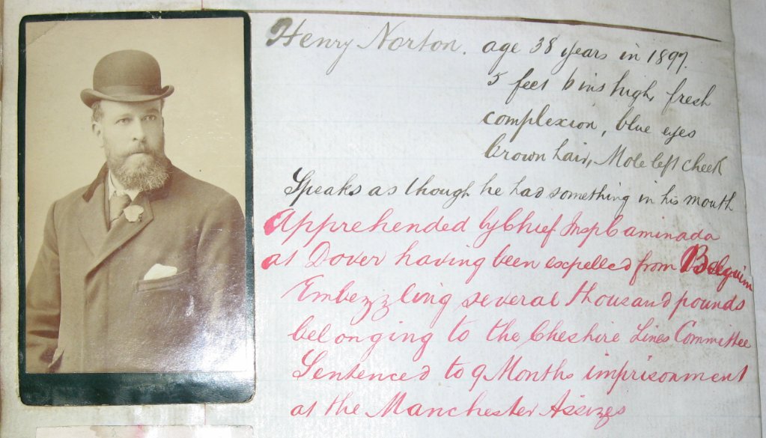
Henry Norton, embezzler, 1897.
“Apprehended by Chief Insp Caminada at Dover”
Notes:
Perhaps Charlie Peace was included as a trophy. Here is a clear example of police triumphalism. One is in no doubt that the most important person in this entry was Chief Inspector Caminada.

Slide 15
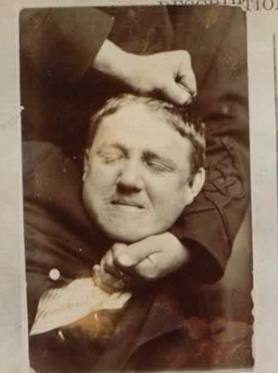
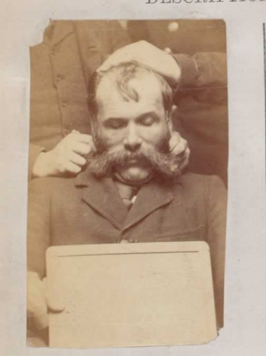
Very few resisted the photograph being taken. Less than one percent of the photos in the Kendal book
Notes:
Very few people struggled to spoil the photo.
It is easy to see the police as agents who have complete control over the offender. These two prisoners are struggling to maintain a semblance of control, but they have missed the point. They had little need to fear the camera as a means of identifying them, for its main purpose was to mark them as criminals. Their struggles did nothing to avoid this mark and little to assert their own agency. The camera was important as a symbol of the power of the state, and their struggles suggest that police power was irresistible. it was a power that was exercised at the grass roots by ordinary police sergeants and inspectors, and magistrates, who used their own beliefs, opinions and prejudices to decide who to photograph, how to do it and what to do with the mugshots taken.

Slide 16
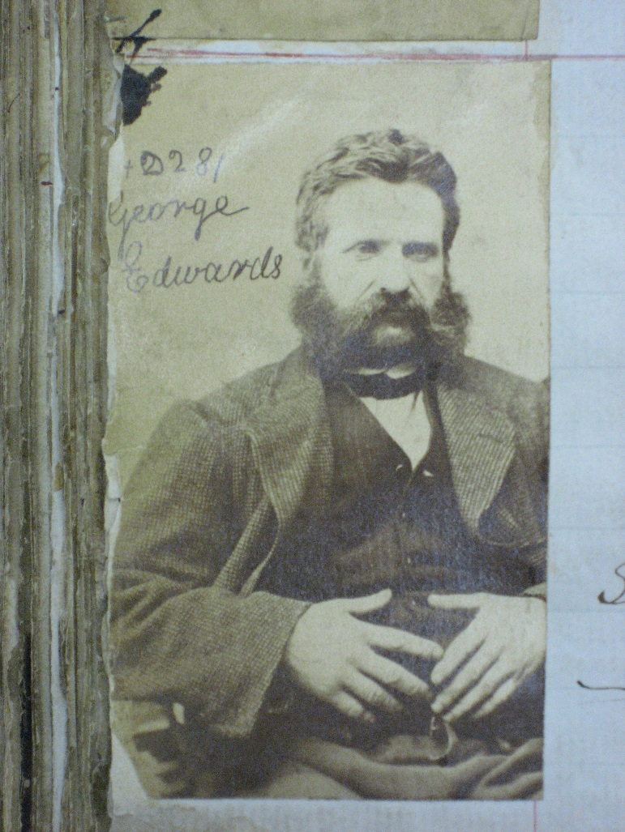
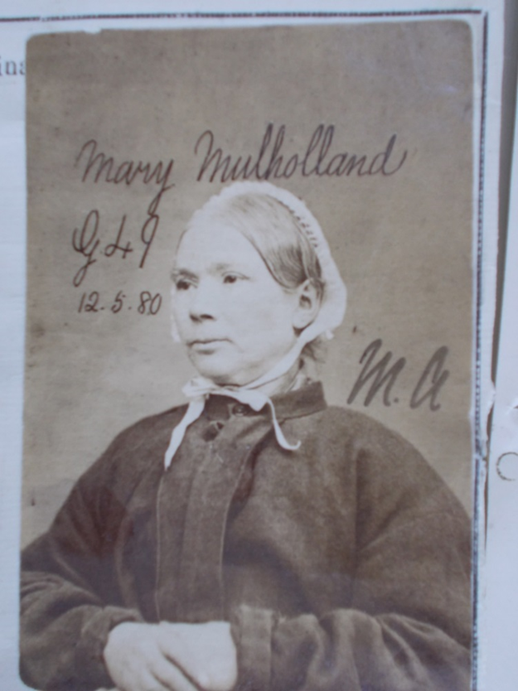
George Edwards
Pickpocket
Manchester 1879
Mary Mulholland
Petty theft, Whitehaven
Millbank, 1880
Notes:
But some prisoners did succeed in exercising agency successfully to deny the absolute power of the police camera. These two have managed to look respectable. George looks like a respectable gentleman who has just enjoyed a fine lunch. By allowing his hands to slip down he has subverted the ‘hands on chest’ rule. Mary has struck a fine pose, presenting herself as a serenely respectable Victorian matriarch

Slide 17
Conclusions
Photography was in the hands of the men in police stations and prisons. Development was a bottom up process.
Photography achieved little in identifying individual offenders, but allowed the marking of types of persons as offenders.
The photograph empowered policemen. They controlled and marked the persons whom they identified as offenders.
Notes:
Conclusions
Photography was in the hands of the men in police stations and prisons. Development was a bottom up process.
Photography achieved little in identifying individual offenders, but allowed the marking of types of persons as offenders.
The photograph empowered policemen. They controlled and marked the persons whom they identified as offenders.

Slide 18
Bibliography
Kathryn Biber, ‘The Spectre of Crime: photography, law and ethics’, Social Semiotics, (2006) 16.1, pp133-49.
Elizabeth Edwards, The Camera as Historian: amateur photographers and historical imagination, (2012) Duke University Press.
Michel Foucault, Politics, Philosophy, Culture: interviews and other writings, 1977-1984, ed. Lawrence Kritzman, trans. A. Sheridan, (1988) Routledge
Peter Hamilton & Roger Hargreaves, The Beautiful and the Damned: the creation of identity in nineteenth century photography, (2001) Lund Humphries
Carney, P., ‘Crime, Punishment and the force of the photographic spectacle’, in Keith Hayward and Mike Presdee, Framing Crime: Cultural Criminology and the Image (2001)
Richard Ireland, ‘The Felon and the Angel Copier: criminal identity and the promise of photography in Victorian England and Wales’, in Louis A. Knafla, Policing and War in Europe (Criminal Justice History, v16, 2002) Greenwood Press, Westport, Conn., pp 53-86.
Jens Jager, ‘Photography: a means of surveillance? Judicial photography, 1850-1900’ Crime, History, Society, (2001) 5.1, pp27-51.
Notes:
Sources used in researching this paper

