Slide 1


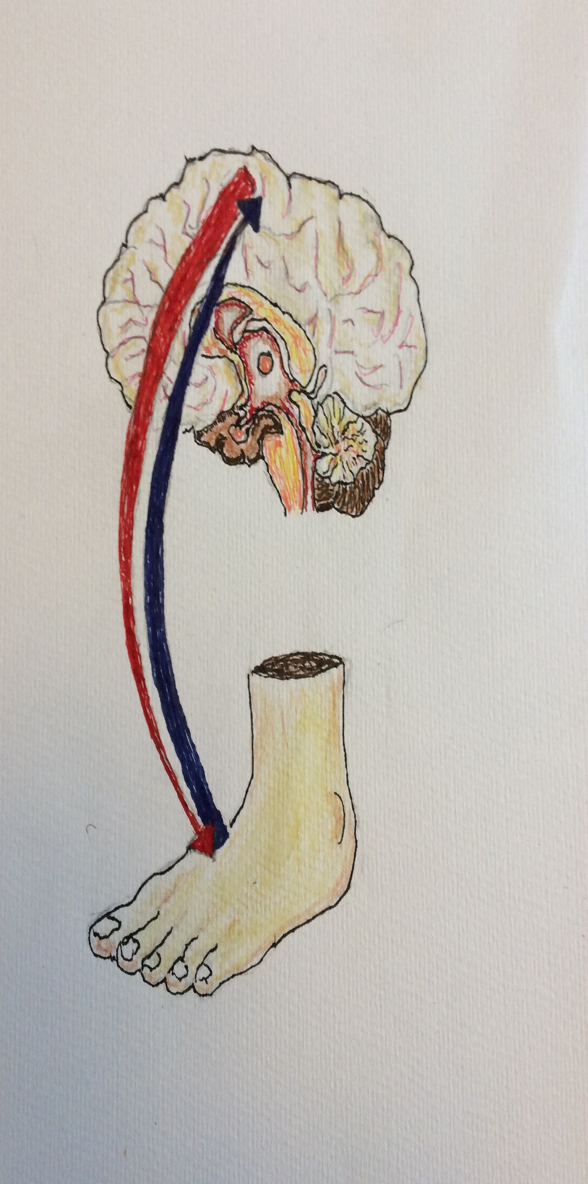

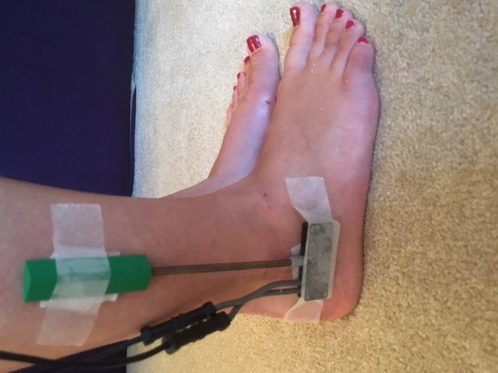
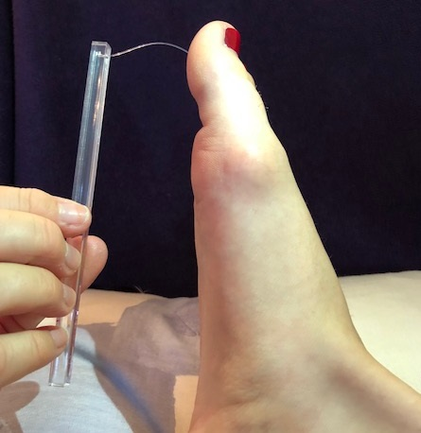
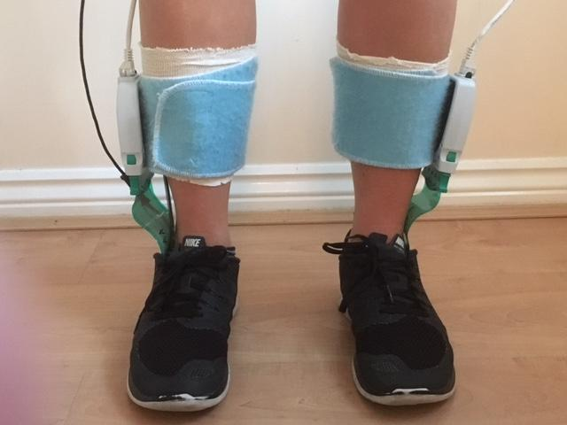
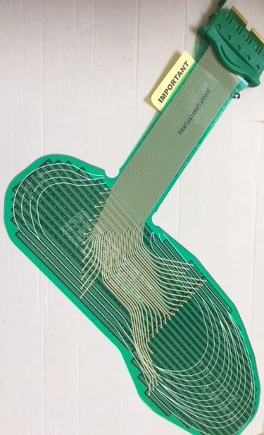
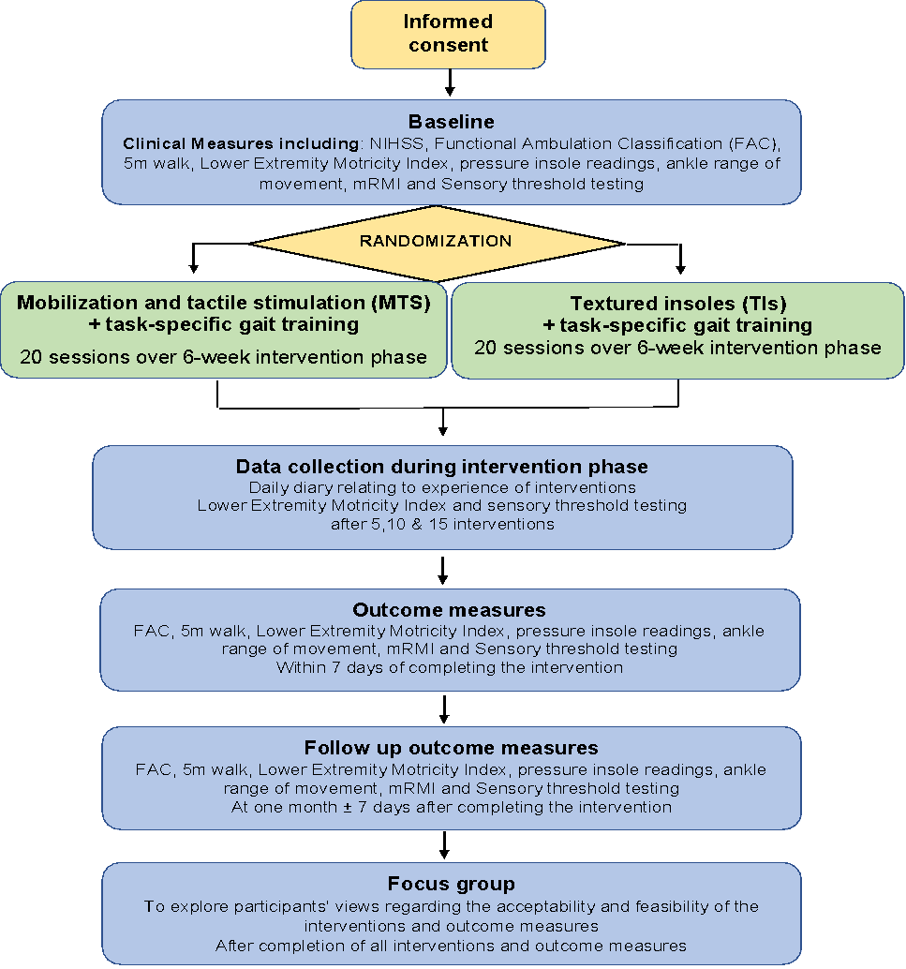
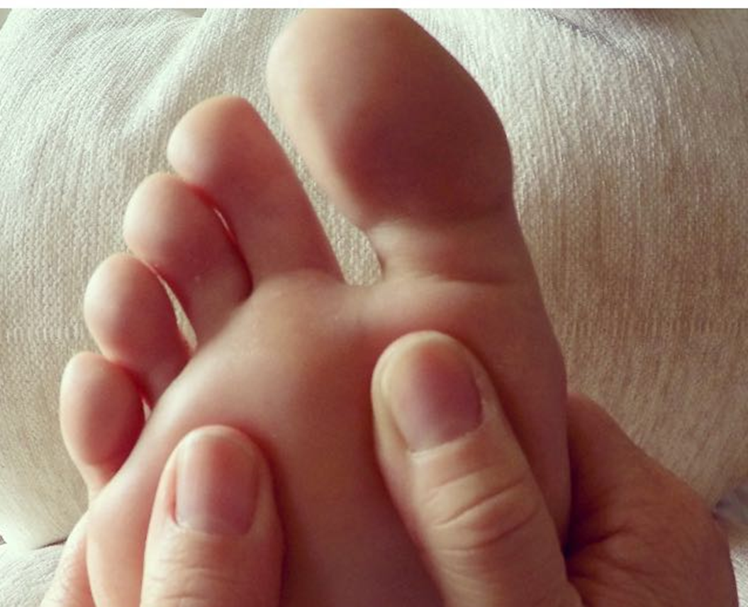
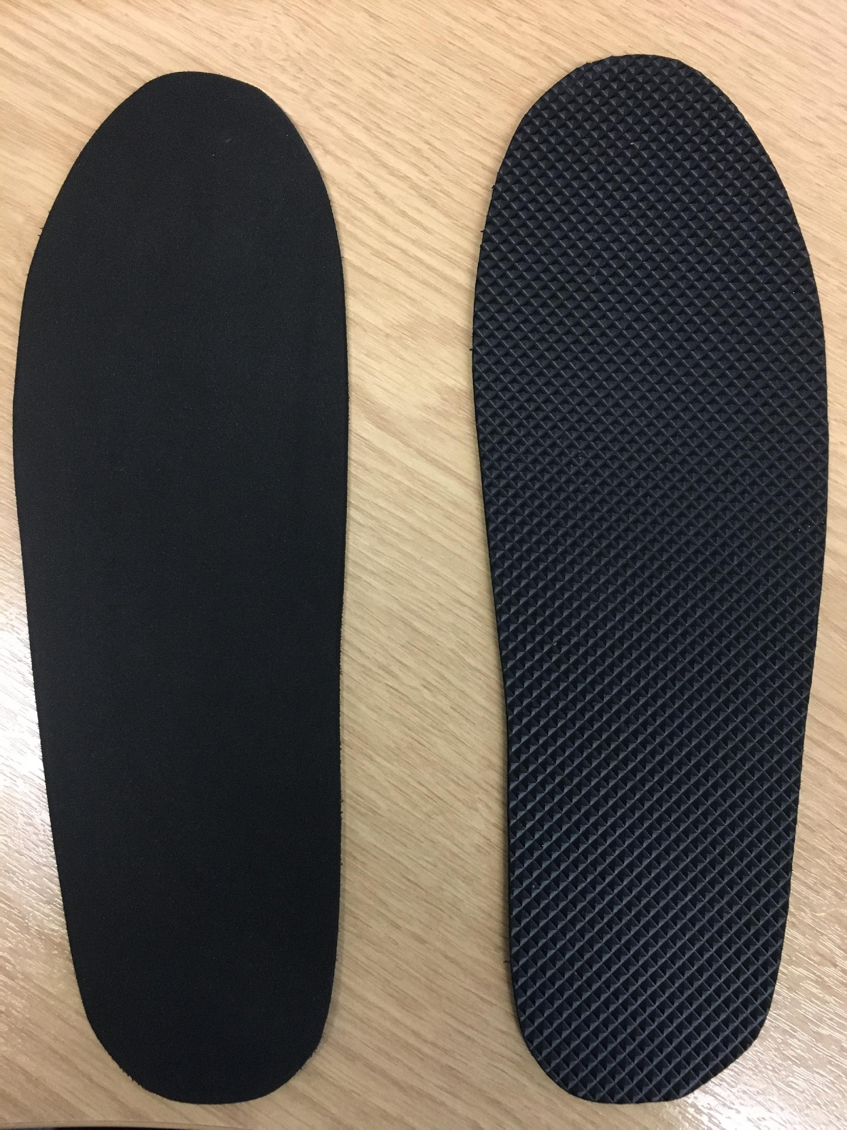
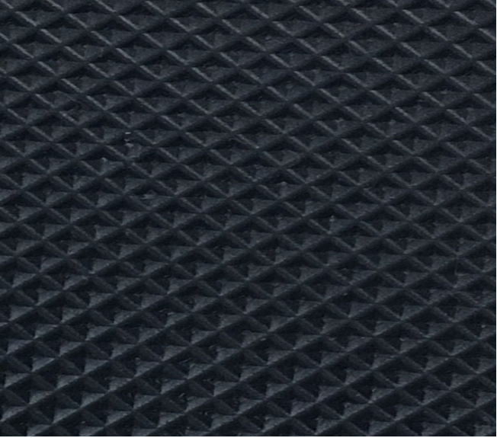

MoTaStim-Foot: a randomised, single-blinded, mixed-methods feasibility study exploring sensory stimulation of the foot and ankle early post stroke
AM Aries ¹, VM Pomeroy ², J Sim ¹, S Read ¹, SM Hunter ¹
¹Faculty of Medicine and Health Sciences, Keele University, UK;
²Acquired Brain Injury Rehabilitation Alliance (ABIRA), School of Health Sciences, University of East Anglia, UK.
INTRODUCTION:
OUTCOME MEASURES:
Ankle range of movement: electrogoniometer. Sensory thresholds: Semmes Weinstein monofilaments. Muscle strength: Lower Extremity Motricity Index (LEMI). Walking ability and speed and function: Functional Ambulation Classification (FAC), 5m walk, modified Rivermead Mobility Index (mRMI). Pressure under feet: Tekscan F-Scan pressure insoles.
RESULTS:
Recruitment, attrition and adherence rates were 48.8%, 5.9% and 97.9% respectively on trial completion (objective 1). Interventions were considered to be comfortable and acceptable by participants in both groups (objective 2). Outcome measures were acceptable to participants and feasible to undertake, many with low cost (objective 3). There was no clear pattern of response over time (objective 4). Diaries and focus groups provided interesting insights into participants’ experiences; diaries were described as ‘simple’’ and ‘valuable’ to complete. Focus groups in particular would be suitable methods to take forward to an RCT (objective 5). Information generated relating to population and sample characteristics will inform design and feasibility of a subsequent RCT (objective 6). Focus group themes: trial experiences, life after stroke, quality of life, empowerment, and acceptance/return to normality after stroke.
Increasing somatosensation of the foot may improve walking recovery after stroke. This study investigated the feasibility of conducting a subsequent randomized controlled trial (RCT). The RCT will determine whether the effect of task-specific gait training is enhanced more with intensive somatosensory stimulation (touch and proprioception) or wearing textured insoles (TIs).
Image by P. Bailey, 2016
RESEARCH OBJECTIVES TO:
Explore recruitment methods and monitor attrition. Explore acceptability of interventions. Investigate feasibility, cost and acceptability of a battery of outcome measures. Explore response to intervention over time. Investigate suitability of daily diaries and focus groups for exploring stroke survivors’ experiences of participating to inform the subsequent RCT. Generate information, i.e. demographics, clinical characteristics, time since stroke, stroke type, co-morbidities.
TRIAL DIAGRAM:
METHODS:
Design: randomized, single-blinded, mixed-methods feasibility study. Setting: rehabilitation ward and community. Participants: 34 people aged 18+ years, 42–112 days post-stroke who provided informed consent. Research ethics: IRAS No:171968, REC: Ref 16/WM/0080.
INTERVENTIONS:
Random allocation to either: 20 sessions of 30–60 minutes of somatosensory stimulation using manual mobilization and tactile stimulation (MTS) techniques (massage, passive/accessory movements, soft tissue and joint mobilizations, facilitated selective movement); or unlimited textured insole wearing; plus 20 sessions of task-specific gait training (both groups) over the 6-week intervention phase.
”It [the trial] was no trouble at all”
” the treatment’s given me the ability to walk”
CONCLUSIONS:
Feasibility was established; a further trial with adequate power is required to explore potential effectiveness of the interventions.
ACKNOWLEDGEMENTS TO:
The participants in the trial, patient and public involvement and engagement volunteers, Keele University as sponsor, Norwich Clinical Trials Unit and the NIHR for funding the trial, as part of the Integrated Clinical Academic Programme. The views expressed are those of the authors and not necessarily those of the NHS, the NIHR or the Department of Health.
CONTACT DETAILS:
Alison Aries: a.m.aries@keele.ac.uk

