Slide 1
Chorionic and amniotic placental membrane-derived stem cells, from gestational diabetic women, have distinct insulin secreting cell differentiation capacities
Figures

Slide 2
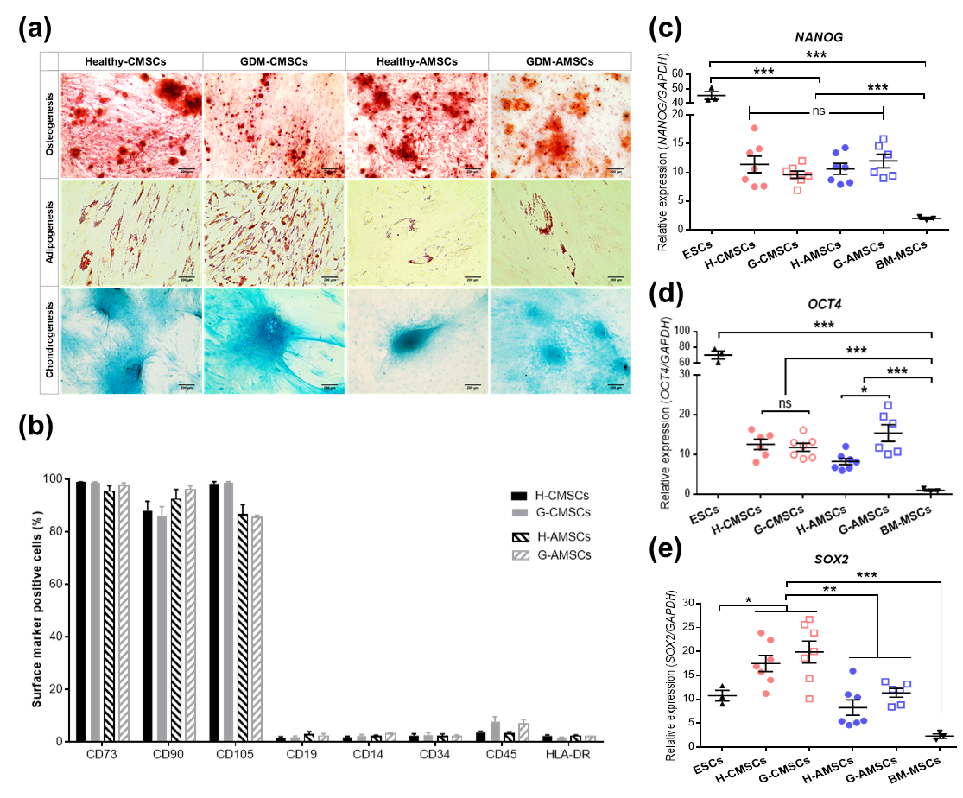
Figure 1

Slide 3
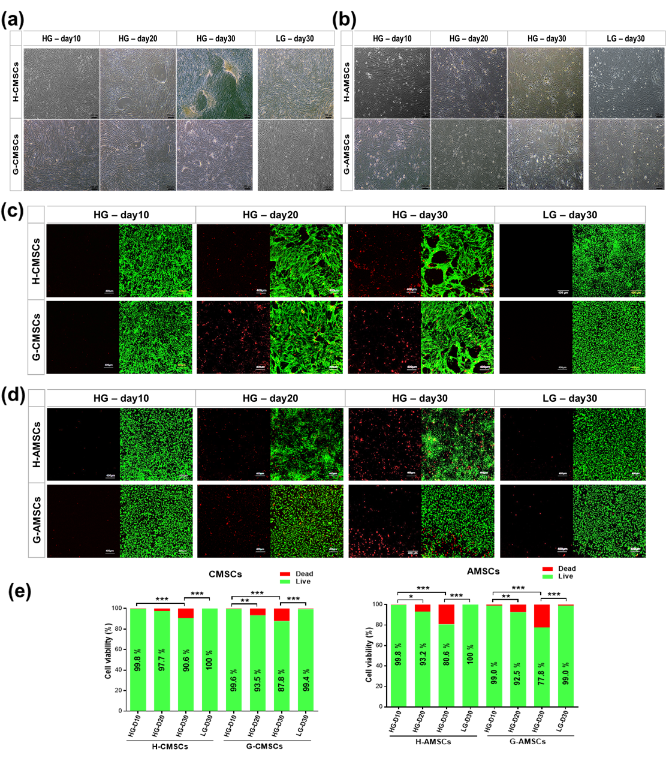
Figure 2

Slide 4
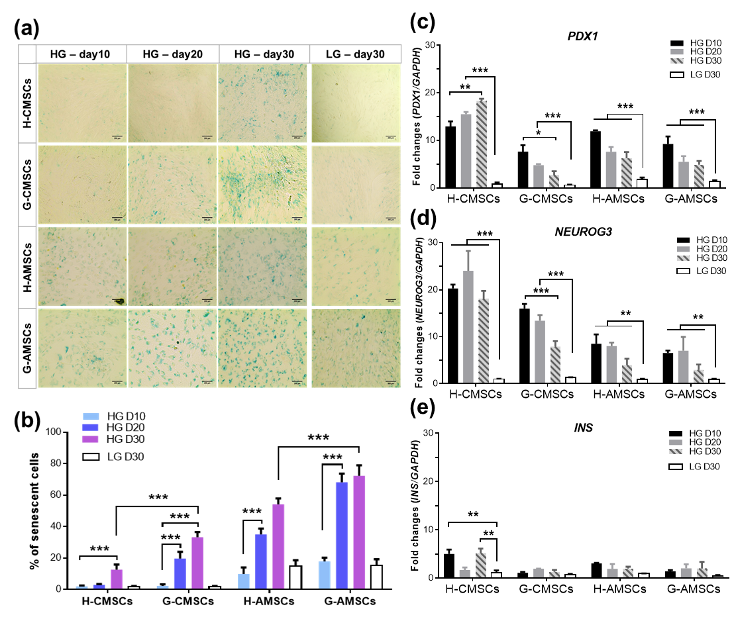
Figure 3

Slide 5
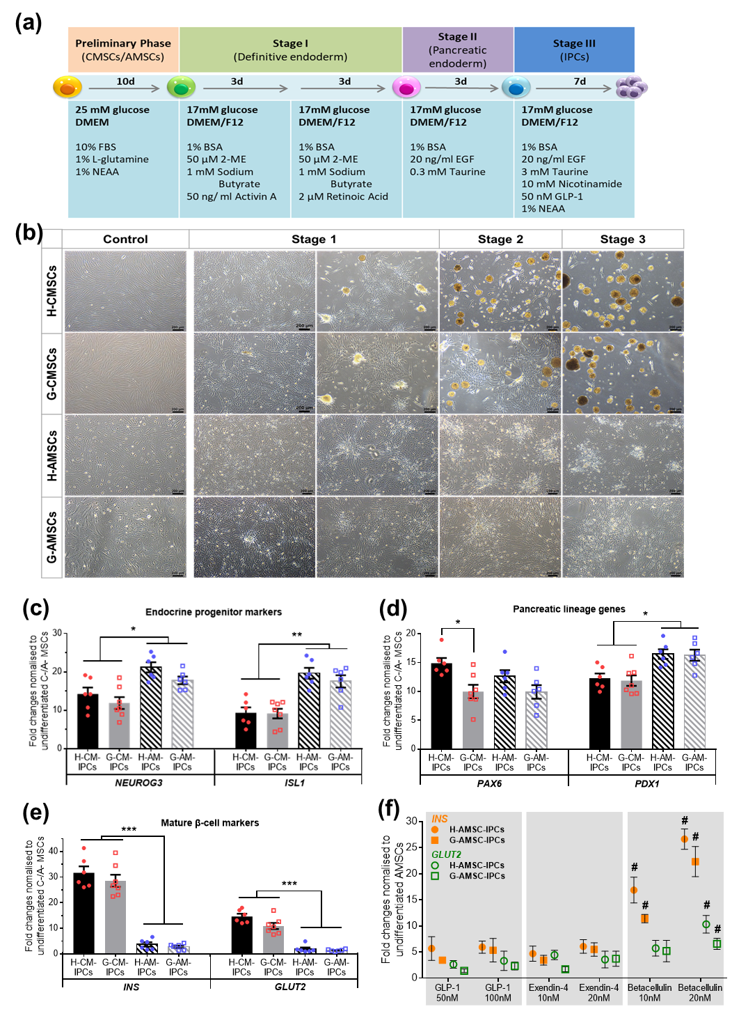
Figure 4

Slide 6
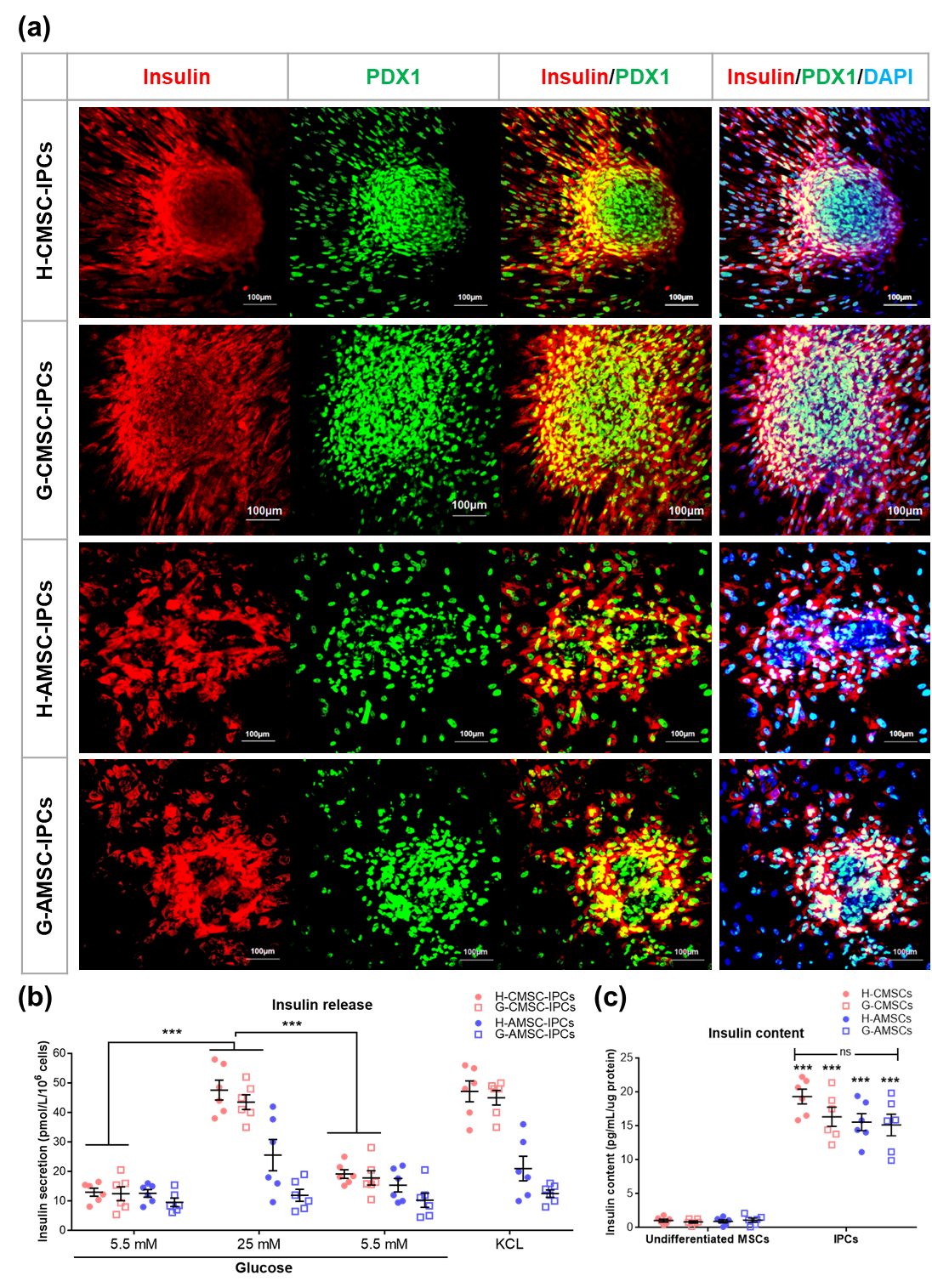
Figure 5

Slide 7
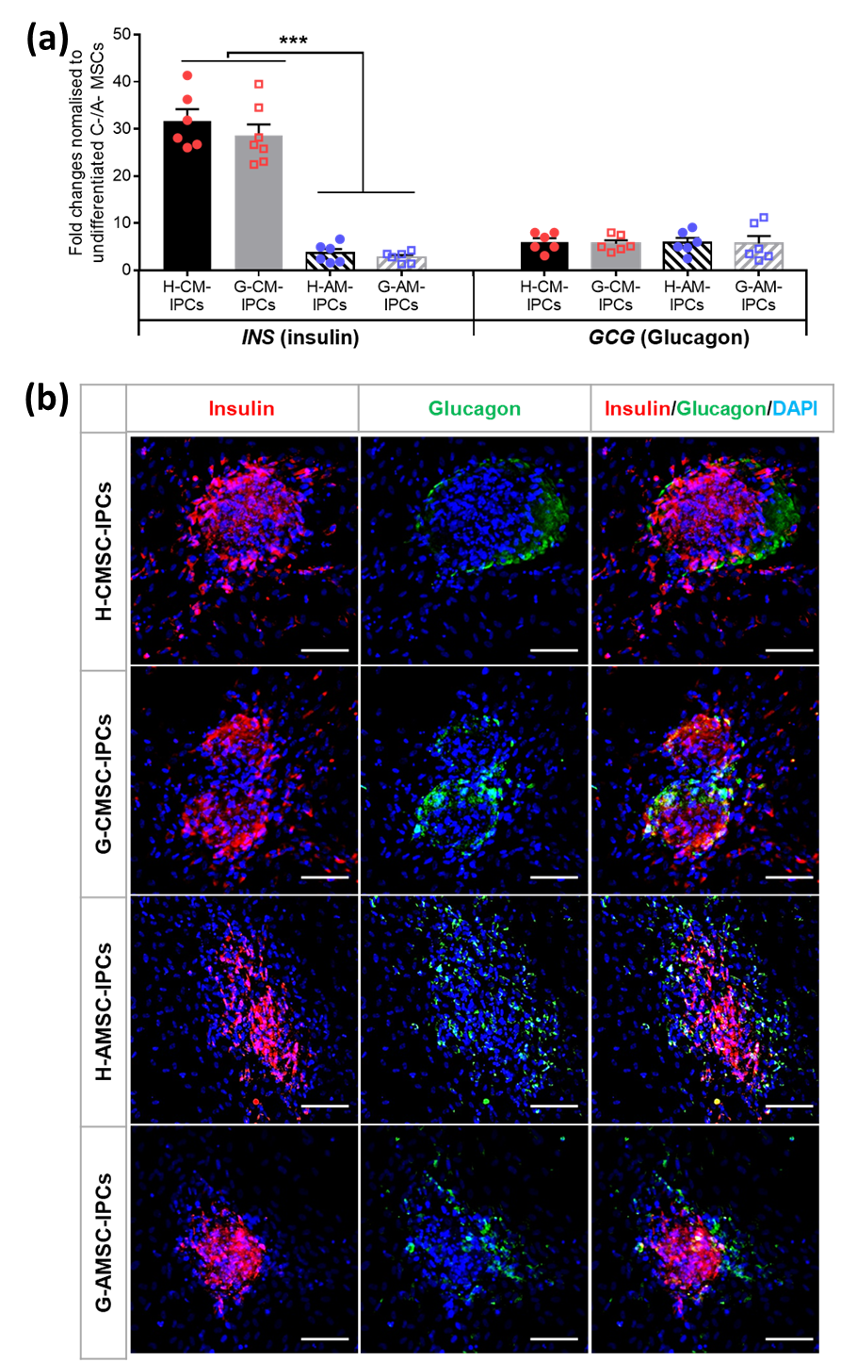
Figure 6

