Slide 1
Assessing Research Grants in the Era of the COVID-19 Pandemic
Dr Andrew England
Senior Lecturer in Radiography
a.england@keele.ac.uk

Slide 2
About Me
Dr Andrew England
Senior Lecturer in Radiography
Academic
Clinical Radiographer (20 years)
Chair – EFRS Educational Wing
2 children
1 dog

Slide 3
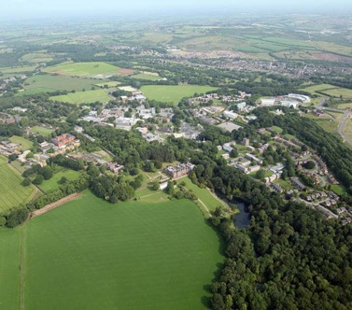
Keele University
A ‘village’ …..
Top 3 UK – student satisfaction
‘GOLD’ in Teaching (TEF)
97% research world-leading / internationally important
96% graduates get jobs

Slide 4
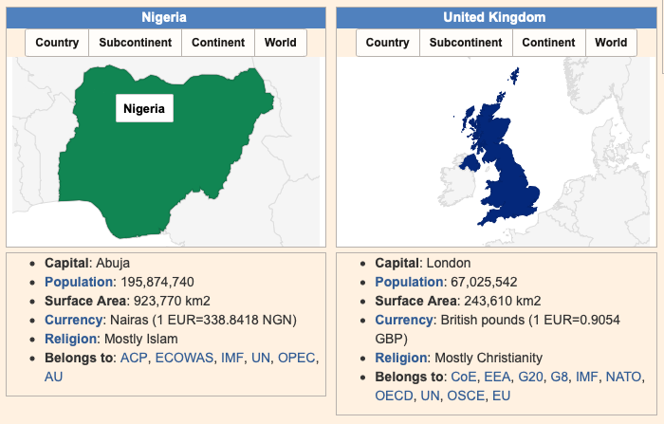
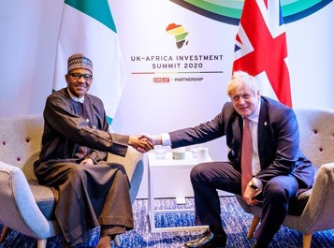
UK & Nigeria (Commonalities)

Slide 5
Three Questions ?????
Is grant funding essential for radiographic research?
Is funding easier to come by in certain parts of the world?
Has COVID-19 made life easier or harder in terms of grant funding?

Slide 6
Lecture Content
COVID-19 > a reminder…
Impact of COVID-19
Global
Financial
Research
COVID-19 ~ research or no research
Opportunities & Challenges
What now / next ….?

Slide 7
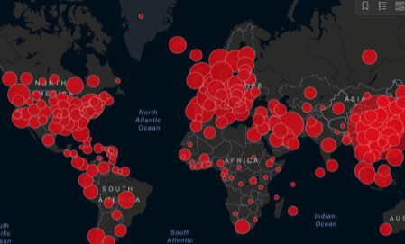
COVID-19 – A Virus
Severe Acute Respiratory Syndrome Coronavirus-2 (SARS-CoV-2)
S & S
Cough / Fever / Unwell
Global
Incidence = 13.6 M (4%)
Mortality = 585K (5%)

Slide 8
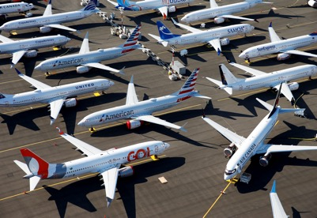
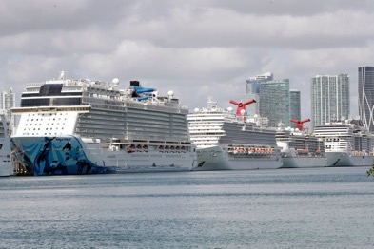
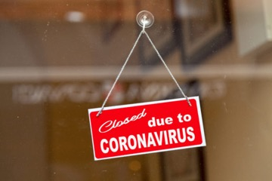
Global Impact of COVID-19
↑ Mortality
↑ Morbidity
↑ Healthcare demand
↓ services
~ Economical
~ Political

Slide 9
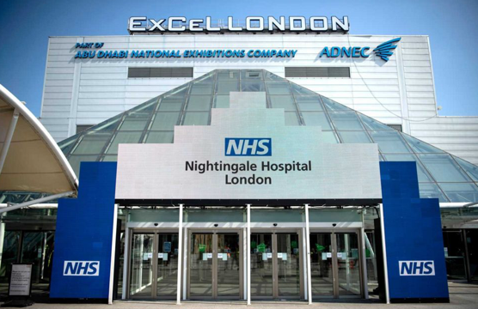
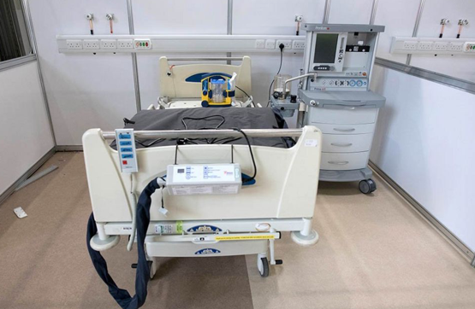
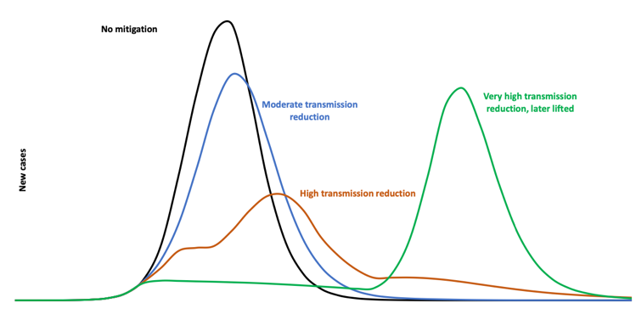
NHS Response to COVID-19
Practical computed tomography tips for radiographers

Slide 10
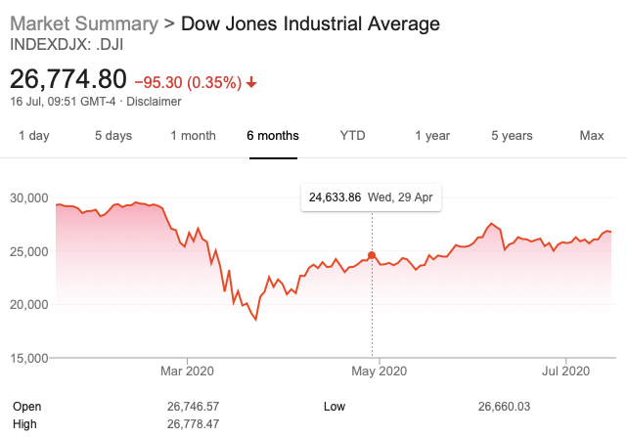
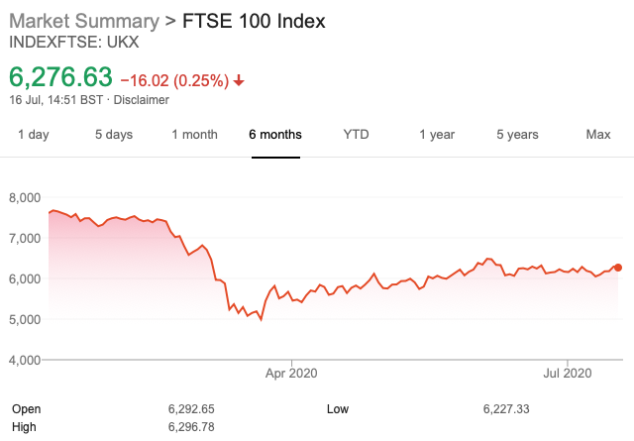
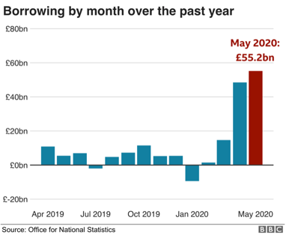
Financial Impact of COVID-19

Slide 11
Impact of COVID-19 on Research
Prioritize frontline care
Focus COVID-19 projects
Other research ‘paused’

Slide 12
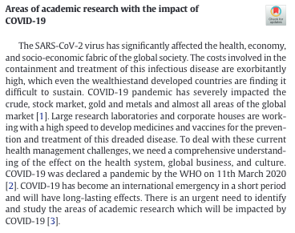
COVID-19 Research
Prevention
Vaccine development
Containment
Treatment
Medication/Therapy
Impact Assessment
Social / Economic / Psychiatric / Environmental / Trade

Slide 13
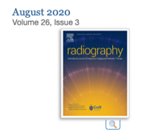
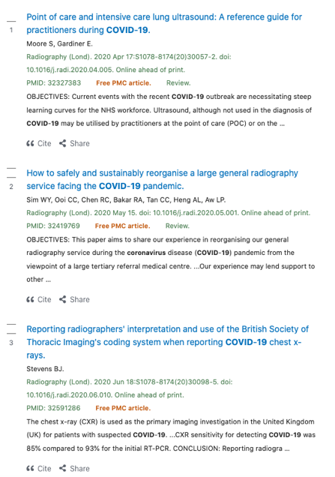
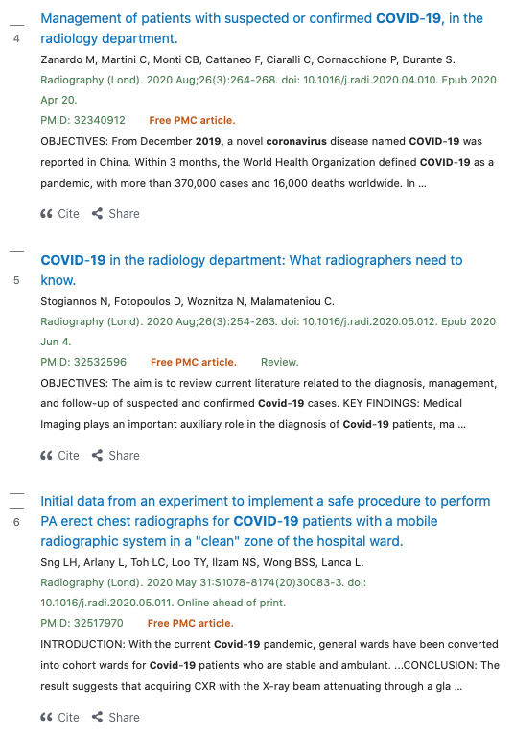
Radiography Research & COVID-19

Slide 14
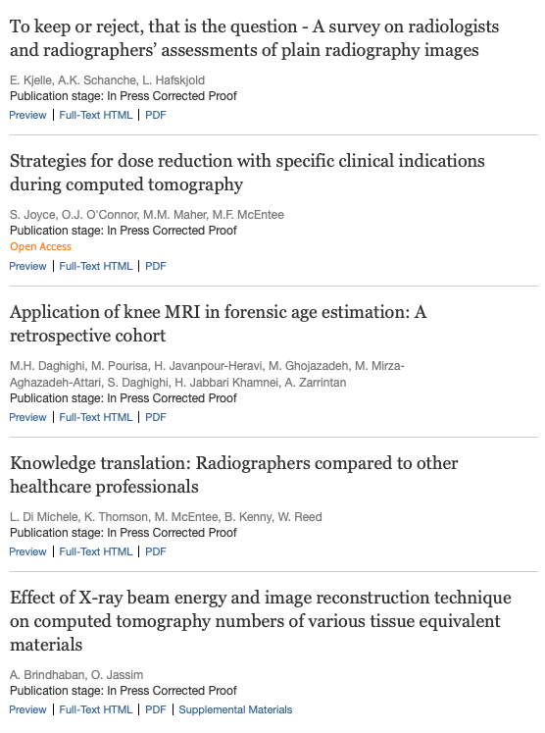
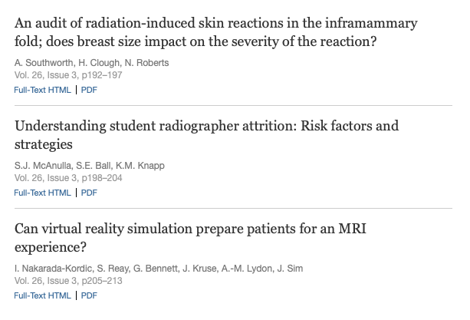
Non-COVID-19 Research

Slide 15
Keeping Research Going (radiographers)
efrs.edu/cpd
https://www.surveymonkey.co.uk/r/efrsTTkeele

Slide 16
Global research areas - most important
Technologies
Digital
Big Data
Artificial Intelligence
Patient Experience
Health inequalities
Global Healthcare
Advancement of Practice
New Imaging Tests
Training & Education
Credentials
Emerging Diseases
Improving Outcomes

Slide 17
End of COVID-19
Vaccine
Effective treatment (for all)
Sub-traceable disease levels (R)
Something else ….. SARS, Zika ..

Slide 18
What will the world now look like for Radiography?
Backlog (waiting lists)
New systems of work (PPE)
Anxiety (2nd Peak)
Professional awareness (public)
Lots to assimilate …

Slide 19
Research (Funding) Opportunities
Personal funds
Hospital / University
Charities
Industry
Government
Non-Government

Slide 20
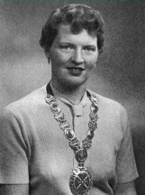
Nigeria/radiography funders
ISRRT (Chesney)
Newton Fund
British Council
https://www.isrrt.org/chesney-isrrt-research-fund (~$3000)

Slide 21
Research (Funding) Challenges
COVID-19 only????
Lack of funding
Government / Charities
Diverted funding
Rebuild economy

Slide 22
Summary
COVID-19
Unimageable global challenges
Duration / impact not fully understood
Research Funding
Opportunities (COVID-19)
Drawbacks (Non-COVID)

Slide 23
Twitter
Facebook
Linkedin
Email – a.england@keele.ac.uk

