Slide 1
Patient Centered Care in Europe ‘Dr Andrew England’
Radiography 2020:
Patient-centred care in the era
of AI and technological innovation

Slide 2
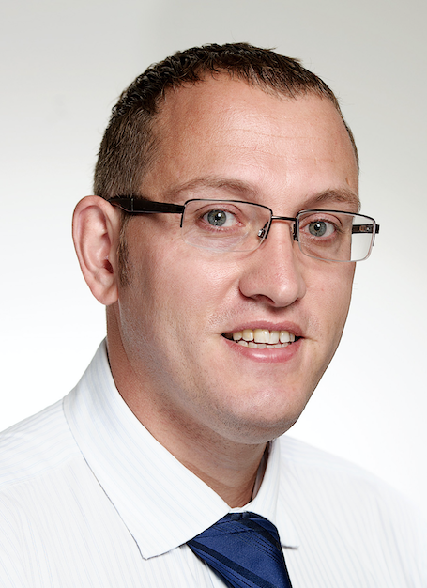
Overview
Me
What is Patient Centered Care (PCC)?
Why is PCC important to radiographers?
Why a European perspective?
PCC, AI & Technology – thoughts…
Role of EFRS in improving PCC

Slide 3
Patient Centered Care – A Concept
Mission & values aligned with patient goals
Full transparency & fast delivery of information
Care is collaborative, coordinated, accessible
An individual’s specific health needs and desired health outcomes are the driving force behind all health care decisions and quality measurements.
Family welcome in care setting
Physical comfort & emotional well-being are top priorities
Patient & family always included in decisions
Patient & family viewpoints respected & valued

Slide 4
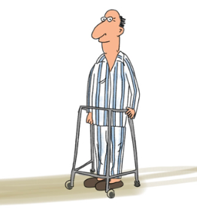
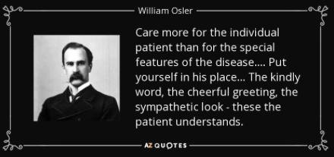
The importance of the individual
Why is patient centered care so important?
Systematic review¹ evidence of PCC:-
More +VE patient outcomes
Greater care satisfaction
Greater job satisfaction
Increased quality & safety of care
Greater quality of life
1. Kuipers SJ, Cramm JM, Neiboer AP. The importance of patient-centered care and co-creation of care for satisfaction with care and physical and social wellbeing of patients with multi-morbidity in the primary care setting. BMC Health Services Research 2019;19(13):doi.org/10.1186/s12913-018-3818-y

Slide 5
Europe & its Radiographers

Slide 6
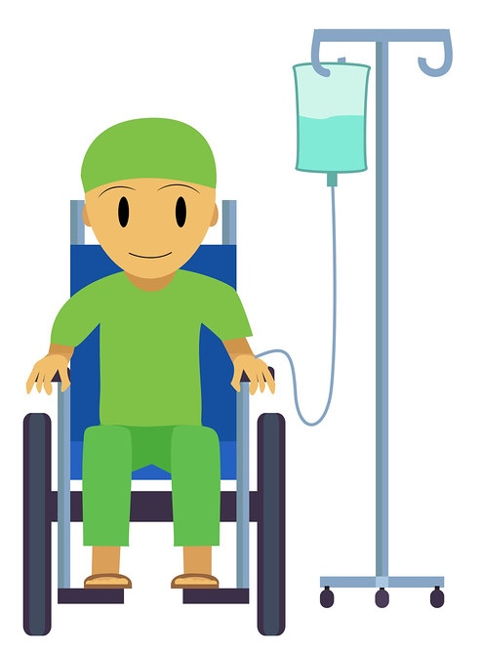
PCC – Getting it Right through AI & Technology²
Access & waiting times
Scheduling & registration
Appropriateness
Patient satisfaction
Reporting
2. Itri JN. Patient-centered Radiology. Radiographics 2015;35(6): doi.org/10.1148/rg.2015150110

Slide 7
The Role of the EFRS in improving PCC
Promote awareness
Generate discussions on implementation
Identify & showcase examples
Act as a global lead / advocate

Slide 9
Thank You !!!
a.england@keele.ac.uk
City, University of London
Northampton Square
London
EC1V 0HB
United Kingdom
T: +44 (0)20 7040 5060
www.city.ac.uk

