Slide 1
Broken Enough
for Broke Britain?
Disability and Suspicion in Times of Crisis

Slide 2
The Chronically Sick and Disabled Persons Act 1970 received royal assent on 9 May 1970. The Act required local authorities to provide welfare services to disabled people who fell within section 29 of the National Assistance Act 1948 (those who were blind, deaf, people with learning disabilities or mental illness and disabled people).
The 1948 act had already given local authorities powers to provide services. However, the 1970 act compelled local authorities to provide a range of services including:
practical assistance
home adaptations
provision of or help with procuring access to recreational activities – such as outings, TV services or educational services, and the provision of meals at home.
Although the act encouraged expanded community based services, it did not adequately fund such services.
The act also placed a duty on local authorities to find out how many people in their areas required services and assistance. Furthermore, the act required local authorities to:
publish information on the services available
inform those who were in receipt of services about the services most suited to their needs.

Slide 3
Lysias (c. 445 – c. 380 BC) ‘Orationa XXIV, The Cripple’, The Orations of Lysias (p. 69) Good Press. Kindle Edition.
“And as proofs of my bodily strength he instances the fact that I ride horseback, and of my skill in my trade that I can associate with men able to be extravagant.”
“I have no other income than this, and if you take it from me, I shall run the risk of coming into the hands of a cruel fate.”
“And that I use two crutches while others use but one, (why does he) not charge me that this is a mark of sound men? But that I ride he uses as a proof to you that I am sound. But both of these I employ for the same reason”

Slide 4
Mr. Alfred Morris. ”Is the Minister aware that the figures published by his right hon. Friend for 1972–73 reveal some shocking variations in local provision? In contrast to the backsliders, there have been many superb achievements by local authorities. Therefore, in the light of the Secretary of State's figures, what action is the Minister taking to lift the general standard to the level of the existing best?”
Mr. Alfred Morris asked the Secretary of State for Social Services if all local authorities are now carrying out the statutory duties laid upon them by Section 1 of the Chronically Sick and Disabled Persons Act 1970 ; and if he will make a further statement.
Mr. Alfred Morris asked the Secretary of State for Scotland if all local authorities in Scotland are now carrying out the statutory duties laid upon them by the provisions of the Chronically Sick and Disabled Persons (Scotland) Act 1970 ; and if he will make a statement.

Slide 5
The UK ratified the Convention in 2009. By following UN CRPD, the UK agrees to protect and promote the human rights of disabled people, including: -
Eliminating disability discrimination; enabling disabled people to live independently in the community; ensuring an inclusive education system; ensuring disabled people are protected from all forms of exploitation, violence and abuse.

Slide 6
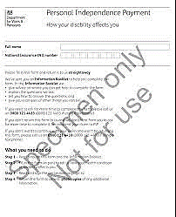
When fully introduced, it is expected that around 600,000 fewer people will receive PIP than would have got DLA, and expenditure will be £2.5 billion a year lower than it would otherwise have been. Introduction of Personal Independence Payment - House of Commons Library (parliament.uk)

Slide 7
Share or comment on this article:
Motability schemes starting to resemble the worst excesses of Arthur Daley...
Comment 136:
“it's time for a serious review of mobility allowances to make sure that only those in real need qualify.”

Slide 8
“Labour will be tough on welfare too, he says. There needs to be responsibility at the top and at the bottom.”

Slide 9
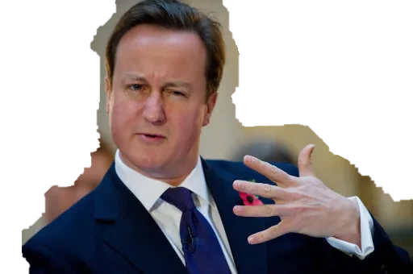
SOCIAL RESPONSIBILITY AND DISABILITY
“In the field of disability, the role of Government is to ensure that the benefits system helps, rather than hinders, disabled people looking for work.
Government is also there to fund and, where necessary, to provide the essential services that disabled people need.
But disabled people need more than Government benefits and Government services.
We need corporate responsibility too: businesses putting in the extra effort, even the extra investment…to ensure that they value and make proper use of the talents and abilities of disabled people.
We need civic responsibility: community groups and local government making sure that disabled people have the fullest access to local services and facilities…and independent organisations being trusted to provide services to disabled people…
https://www.ukpol.co.uk/david-cameron-2006-speech-on-disabled-people/

Slide 10
SOCIAL RESPONSIBILITY AND DISABILITY (continued)
…and finally, we need personal responsibility. This means each of us, as individuals.
Disabled people need to take the responsibility of looking for work if they can, of taking their place in society.
And non-disabled people need to combat their own prejudice and the prejudice of others – to recognise the equal rights of all people to respect and dignity.”
https://www.ukpol.co.uk/david-cameron-2006-speech-on-disabled-people/

Slide 11
Disabled or Faking It?
Panorama Declan Lawn reports on plans to get millions of people claiming disability benefits back into work. But will new assessment tests victimise those who deserve the most support?

Slide 12
London 2012 Paralympics

Slide 13
Awareness-raising (art. 8)
The Committee is concerned at the persistence of negative attitudes, stereotypes and prejudice against persons with disabilities, particularly persons with intellectual and/or psychosocial disabilities and persons with neurological and cognitive conditions such as dementia and Alzheimer’s, and about their social protection entitlements
23. The Committee recommends that the State party, in close collaboration with organizations of persons with disabilities, strengthen its awareness-raising campaigns aimed at eliminating negative stereotypes and prejudice towards persons with disabilities, particularly persons with intellectual and/or psychosocial disabilities and persons with neurological and cognitive conditions such as dementia and Alzheimer’s. To that end, the State party should include mass media strategies and campaigns, with different target audience groups, based on the human rights model of disability. First periodic review (2017)
The UN conducted its first periodic review of how the UK had implemented the UN CRPD in 2017.
UN Committee investigation (2016)
In 2016 the UK was investigated under the Optional Protocol of the UN CRPD following a formal request from several disability organisations. The UN Committee on the Rights of Persons with Disabilities found that “grave or systematic violations” of disabled persons’ rights had taken place because of welfare reforms in the UK since 2010 (opens a Word file).
The Committee said welfare reforms had “disproportionally and adversely” affected the rights of people with disabilities, citing changes to Housing Benefit entitlement, eligibility criteria for Personal Independence Payment (PIP) and social care, and the ending of the Independent Living Fund.

Slide 14
“There is a small {pauses}, a group [disabled people], who are quite frankly not worth paying minimum wage.”
- Lord Freud, Minister of State
for Welfare Reform
(11 May 2010 – 21 Dec 2016)

Slide 15
ABSTRACT
This article considers the appositeness of maintaining the defences of 'reasonable adjustment' and 'undue burden' in legislation relating to the rights of persons with disabilities, and what the maintenance of these concepts with legislative parlance demonstrates about the true status and progress of disability rights in the United Kingdom today. This will be illustrated by an analysis of the Equality Act 2010 and various cases concerning the rights of people with disabilities in relation to dignity and autonomy. The discussion is framed by an analysis of Lord Freud's comments at a recent conference and the disparity between the continued focus on the economics of providing access provisions to persons with disabilities and the emphasis of the United Nations Convention on the Rights of Persons with Disabilities (CRPD) on the fundamental human rights of: dignity, autonomy, recognition and participation. The article will propose that the notions of ‘reasonable adjustment’ and ‘undue burden’ should be removed completely from legislative vocabulary and replaced with the phrase: ‘assurance of rightful access’ and how this may be achieved in practice.
WHAT’S WORTH GOT TO DO WITH IT? LANGUAGE AND THE SOCIO-LEGAL ADVANCEMENT OF DISABILITY RIGHTS AND EQUALITY
Abigail Victoria Pearson
ABSTRACT
This article considers the appositeness of maintaining the defences of 'reasonable adjustment' and 'undue burden' in legislation relating to the rights of persons with disabilities, and what the maintenance of these concepts with legislative parlance demonstrates about the true status and progress of disability rights in the United Kingdom today. This will be illustrated by an analysis of the Equality Act 2010 and various cases concerning the rights of people with disabilities in relation to dignity and autonomy. The discussion is framed by an analysis of Lord Freud's comments at a recent conference and the disparity between the continued focus on the economics of providing access provisions to persons with disabilities and the emphasis of the United Nations Convention on the Rights of Persons with Disabilities (CRPD) on the fundamental human rights of: dignity, autonomy, recognition and participation. The article will propose that the notions of ‘reasonable adjustment’ and ‘undue burden’ should be removed completely from legislative vocabulary and replaced with the phrase: ‘assurance of rightful access’ and how this may be achieved in practice.

Slide 16
PIP investigation: 200 cases of dishonesty… and still DWP, Atos and Capita refuse to act
By John Pring on 3rd August 2017 The government and its private sector contractors are refusing to investigate claims of widespread dishonesty in the benefits assessment industry, despite Disability News Service (DNS) collecting more than 200 such cases.
The cases have been compiled during a DNS investigation into allegations that healthcare professionals working for outsourcing giants Capita and Atos have been lying in personal independence payment (PIP) assessment reports they have written for the Department for Work and Pensions (DWP).
https://www.disabilitynewsservice.com/author/john-pring/

Slide 17
Philippa Day. A disabled woman, who apparently took her own life in despair at the way her benefits claim was being dealt with, left a note that “directly implicated” the Department for Work and Pensions (DWP) in her death.

Slide 18
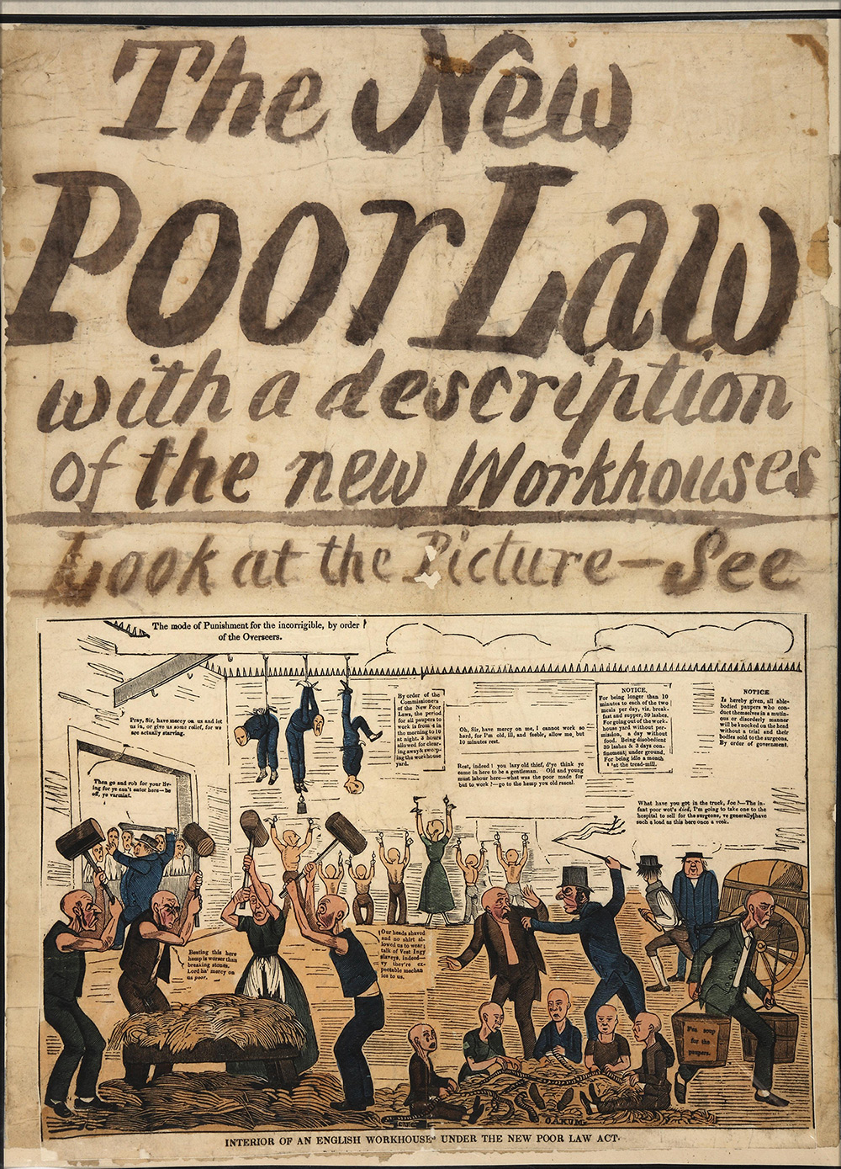
The Poor Law 1834
The 1834 English Poor Law distinguished between the ‘deserving’ and the ‘undeserving poor’, the former being those who through no fault of their own—disability, age, sickness—could not provide for themselves, and the latter being the feckless and work-shy, a burden on their communities and undeserving of any but the harshest of treatment from good hardworking people and the instruments of the state. The Poor Law was replaced by the modern welfare state, yet its legacy lives on—except that, of course, we have removed the outmoded notion that there are some in our society who will always need the support of others in favour of a rhetorical championing of ‘hardworking families’.
Editorial | The British Journal of Social Work | Oxford Academic (oup.com)

Slide 19
Published in July 2021, the National Disability Strategy (NDS), purports to be a cross-government strategy to improve the lives of disabled people.
In Jan 2022, the High Court ruled the strategy unlawful, based on a case brought by four disabled people in relation to the consultation process.
The Government has applied for permission to appeal.

Slide 20
National Disability Strategy: ‘once in a generation plan’ has been seen before
Abigail Victoria Pearson
The UK government’s National Disability Strategy and £1.6 billion in funding was announced recently with great fanfare.
Politicians hailed it as a landmark initiative, but on closer inspection, the document is not quite as innovative as advertised – many of the elements contained in it were first considered decades ago, and are long overdue.
Boris Johnson described the plan as the greatest government development in disability equality policy since the passage of the Disability Discrimination Act, by John Major (although I’m sure the disabled activists who campaigned and protested for the act would remember its history differently).
The plan is wide ranging, with focuses on access in work, education, healthcare, housing, transport, recreation and leisure and access to goods and services. It outlines steps the government needs to take to remove physical, administrative and attitudinal barriers to access.

Slide 21
The Government’s proposal to Cancel the Levy
On 22 September 2022 the Chancellor Kwasi Kwarteng announced that the 1.25% rise in NICs rates for employees, employers and the self-employed would be reversed from 6 November 2022. In addition the Health and Social Care Levy would be cancelled.
The Health and Social Care Levy (Repeal) Bill 2022-23 was introduced the same day.
In their Business Statement on this day the Leader of the House announced that the Bill would be ‘fast-tracked’, with all of its stages in the House of Commons taken on 11 October.
Subsequently, on 11 October the House approved a motion for all of the Bill’s stages in the Commons to be taken that day, and the Bill was agreed, unamended.
The Health and Social Care Levy (Repeal) Act 2022 received Royal Assent on 25 October 2022.
The Treasury published a factsheet on the Bill, noting that the increase in tax rates on dividend income, which were announced along with the Levy and took effect from April 2022, would be reversed from April 2023.
The factsheet stated that “the Levy and increased dividend tax was expected to raise approximately £13 billion a year to fund health and social care. Funding for health and social care services will be maintained at the same level as if the Levy was in place.”
As noted above, as part of the Autumn Statement 2022, the Government announced that it was delaying the rollout of adult social care charging reform from October 2023 to October 2025.

Slide 22
Disability Policy
Law and Politics
Context:
Austerity and other crises
Benefit Fraud
Public Opinion

Slide 23
Thank
You

