Slide 1
Z-stack images for the 3D hydrogel constructs

Slide 2
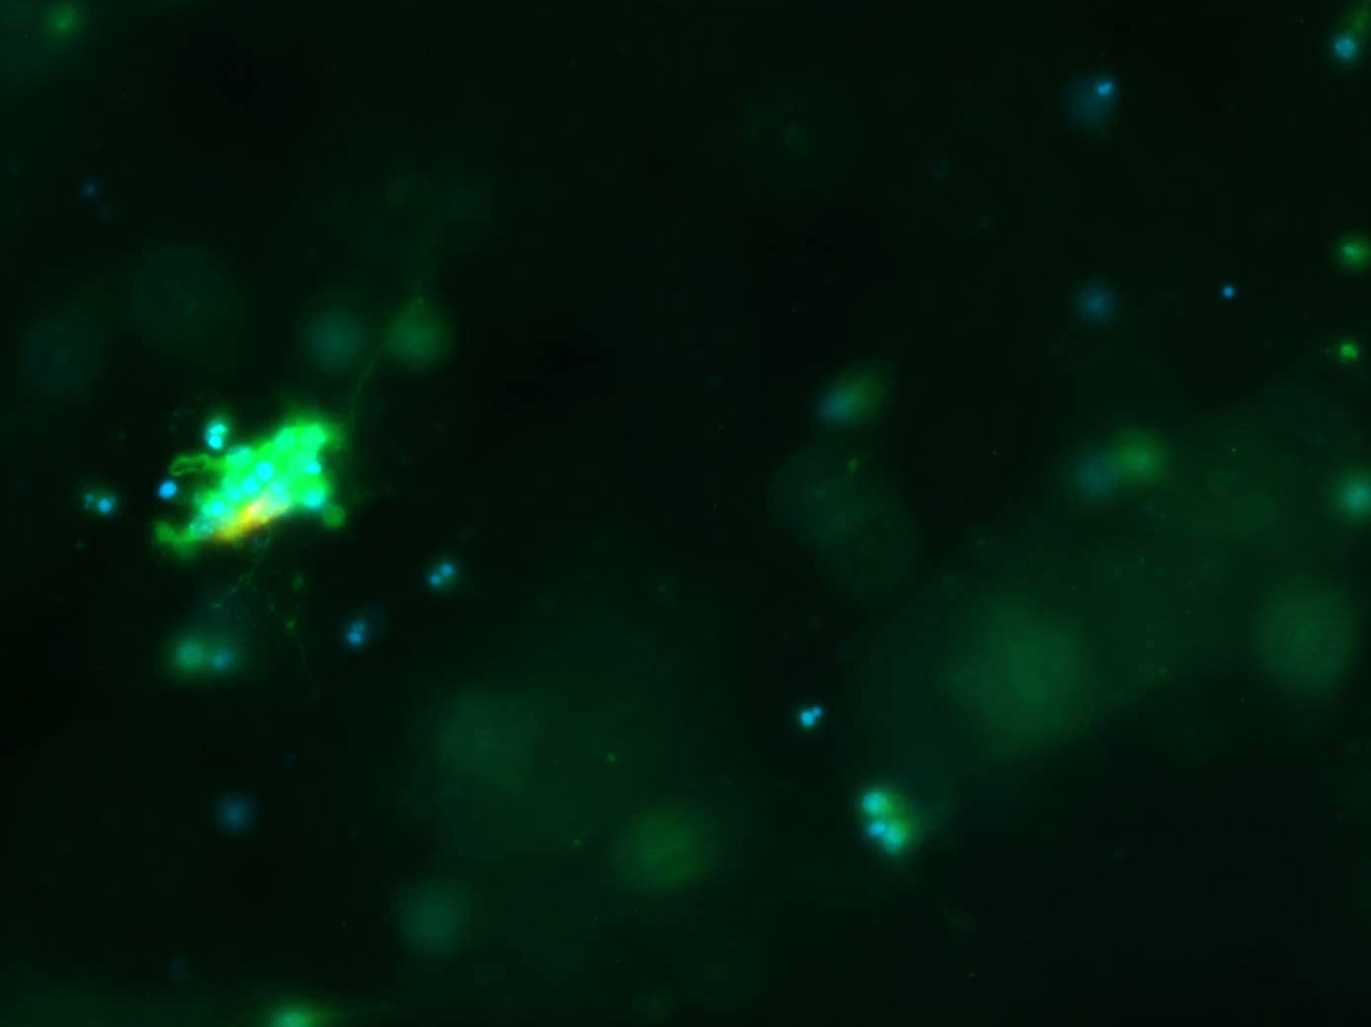
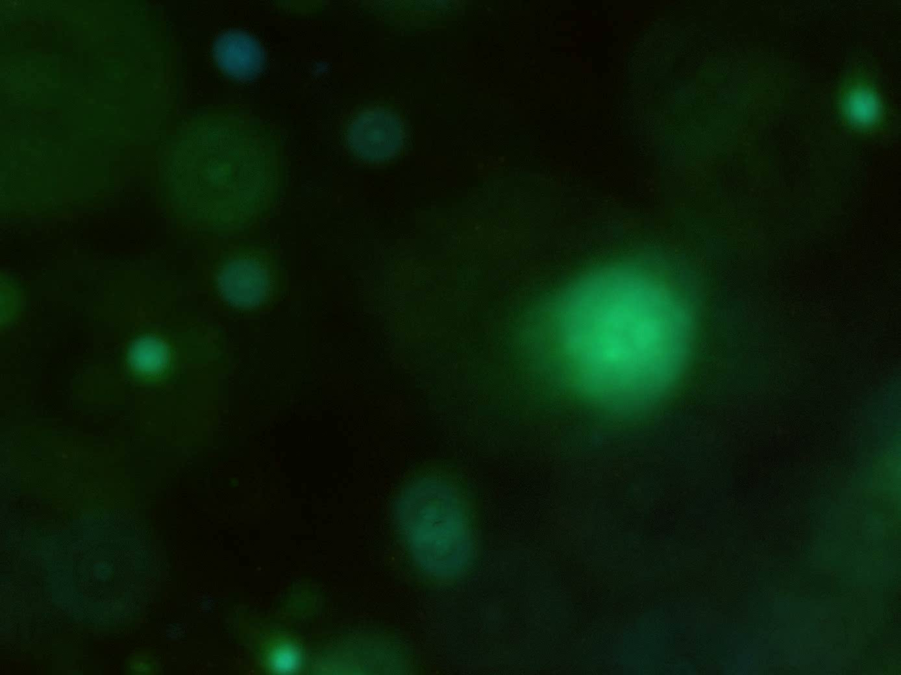
The purity of cortical culture at 3 days in vitro in hydrogel scaffolds
Figure 5.5: Highly pure and homogenous neuronal 3D hydrogel construct at 3 days in vitro. Fluorescent z-stack image series throughout the collagen hydrogel construct (distance between each image 10 µm), divided into 3 groups: top of gel (upper layer), the middle of the gel (middle layer) and the bottom of the gel (lower layer).

Slide 3
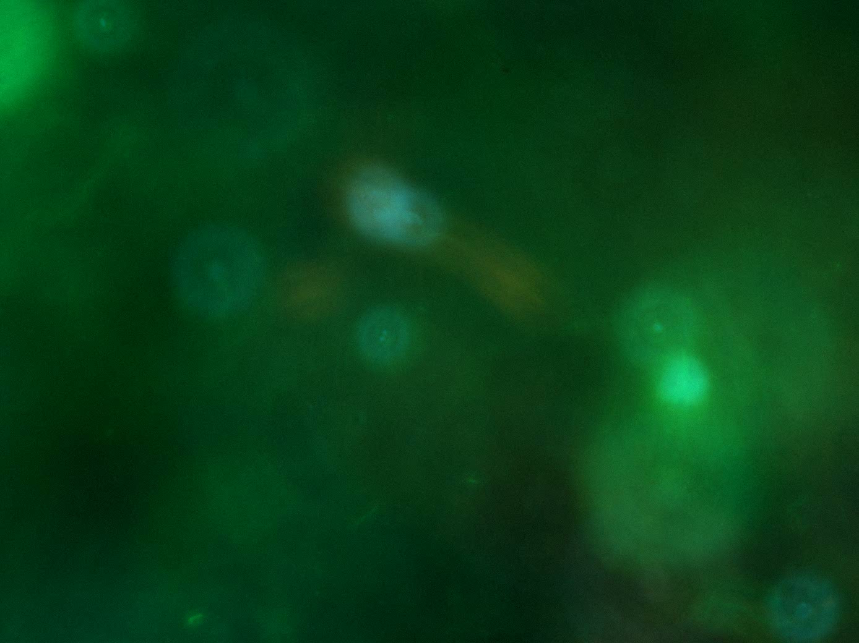
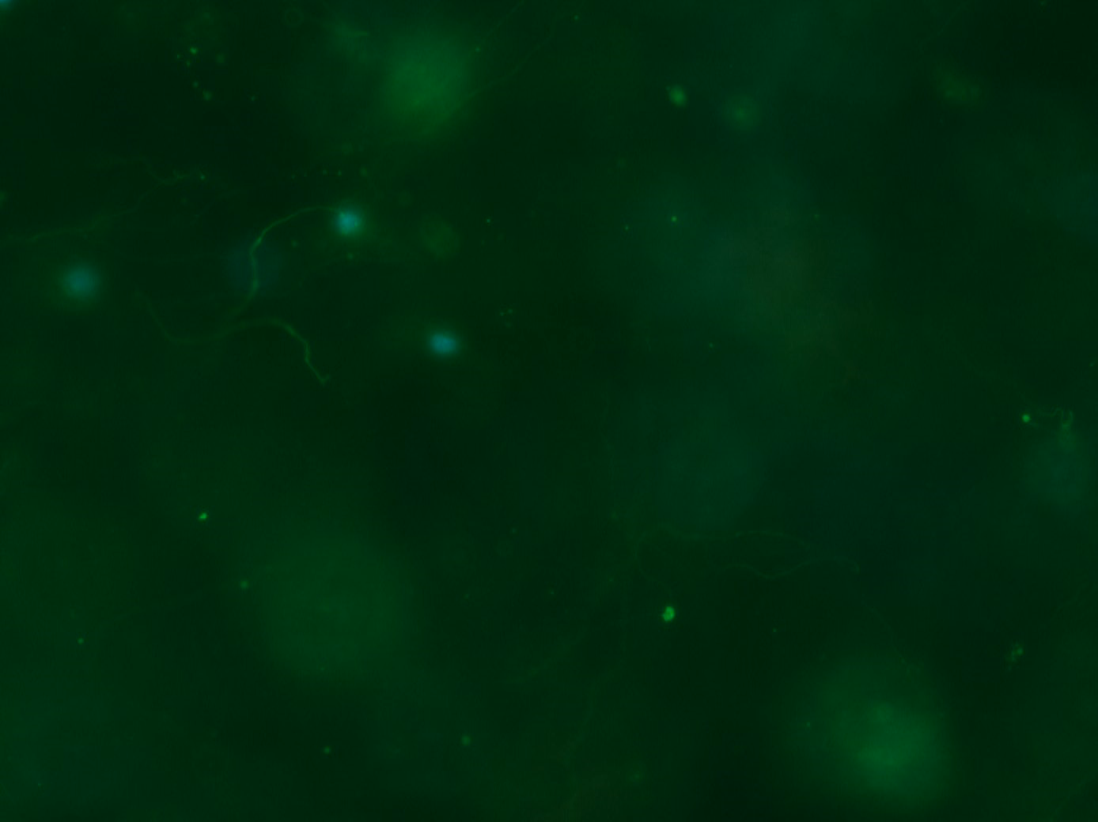
The purity of cortical culture at 7 days in vitro in hydrogel scaffolds
Figure 5.6: Pure and homogenous neuronal 3D hydrogel construct at 7 days in vitro. Fluorescent z-stack image series throughout the collagen hydrogel construct (distance between each image 10 µm), divided into 3 groups: top of gel (upper layer), the middle of the gel (middle layer) and the bottom of the gel (lower layer).

Slide 4
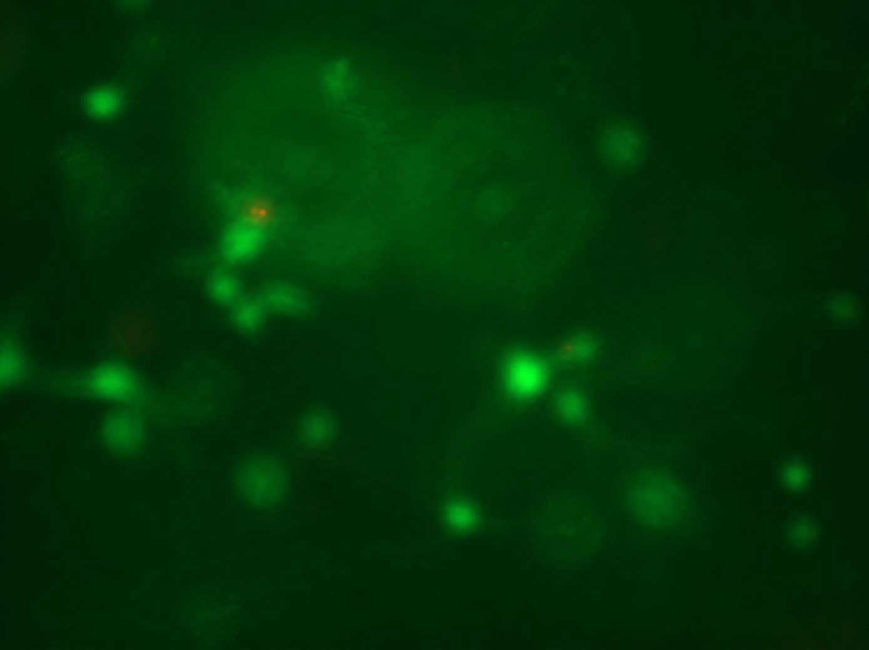
Viability of cortical cells in 3D environment
Figure 5.9:Collagen hydrogels support cortical cell survival in a 3-dimensional environment. Fluorescent z-stack images show dead cells stained with Ethidium homodimer (red) (A) and viable cells stained with Calcein (green).

Slide 5
Transfecting cortical cells within 3D hydrogel construct

Slide 6

Gel 1
Tuj-1
GFP
DAPI
Figure 5.13: Genetically engineered cortical cells in a 3-dimensional hydrogel construct. Series of z-stack images through the 3 different layers of the hydrogel construct (gel 1).Shows the transfected neurons localized in the bottom layer of the hydrogel construct. Gels were stained with a – Tuj-1, b – DAPI and c – anti GFP. Channels were merged to produce D.

Slide 7

Gel 2
Tuj-1
GFP
DAPI
Figure 5.13: Genetically engineered cortical cells in a 3-dimensional hydrogel construct. Series of z-stack images through the 3 different layers of the hydrogel construct (gel 2).Gel 2 demonstrates that the neurons in the middle of the hydrogel can be transfected Gels were stained with a – Tuj-1, b – DAPI and c – anti GFP. Channels were merged to produce D.

Slide 8
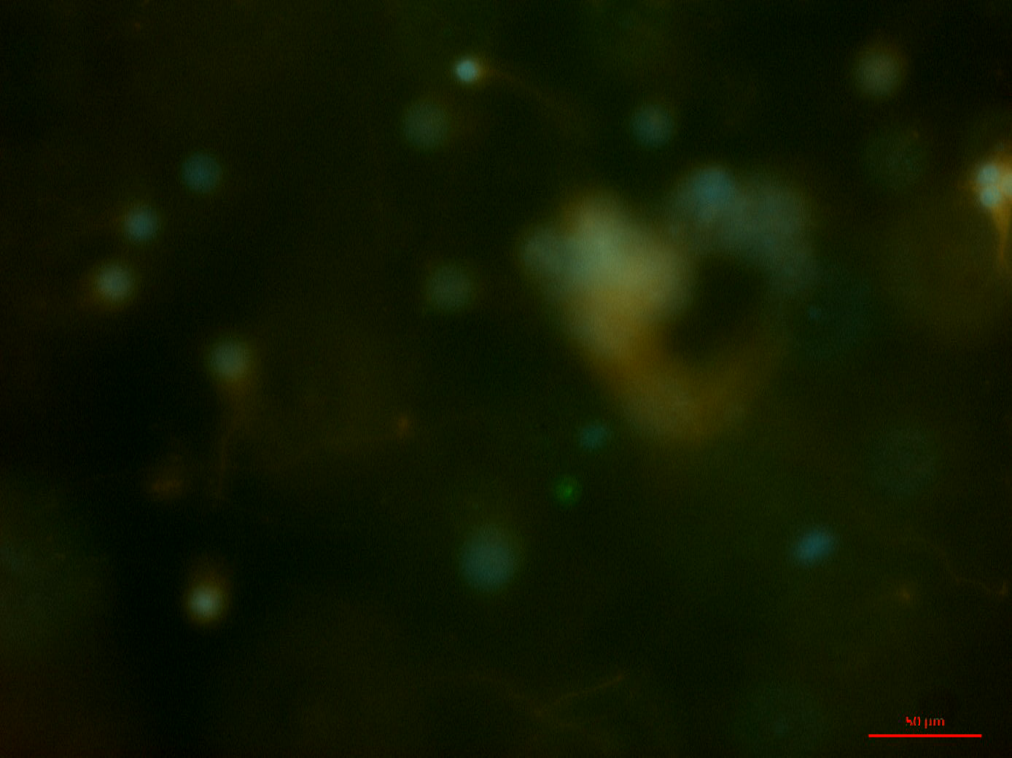
Gel 3
Tuj-1
GFP
DAPI
Figure 5.13: Genetically engineered cortical cells in a 3-dimensional hydrogel construct. Series of z-stack images through the 3 different layers of the hydrogel construct (gel 3 sample). Shows transfected astrocytes localized on the surface of the hydrogel construct. Gels were stained with a – Tuj-1, b – DAPI and c – anti GFP. Channels were merged to produce D.

