Slide 1
‘I did not know I could learn so many skills, from playing games’ – Using reflection as a form of assessment in legal ed game-based learning.
Dr Laura Higson-Bliss

Slide 2
Demographics
44 students all level 3 – Different educational backgrounds
SOME Mature students
ENROLLED IN DIFFERENT PROGRAMMES INCLUIDNG, LAW, SOCIAL WORK AND humanities

Slide 3
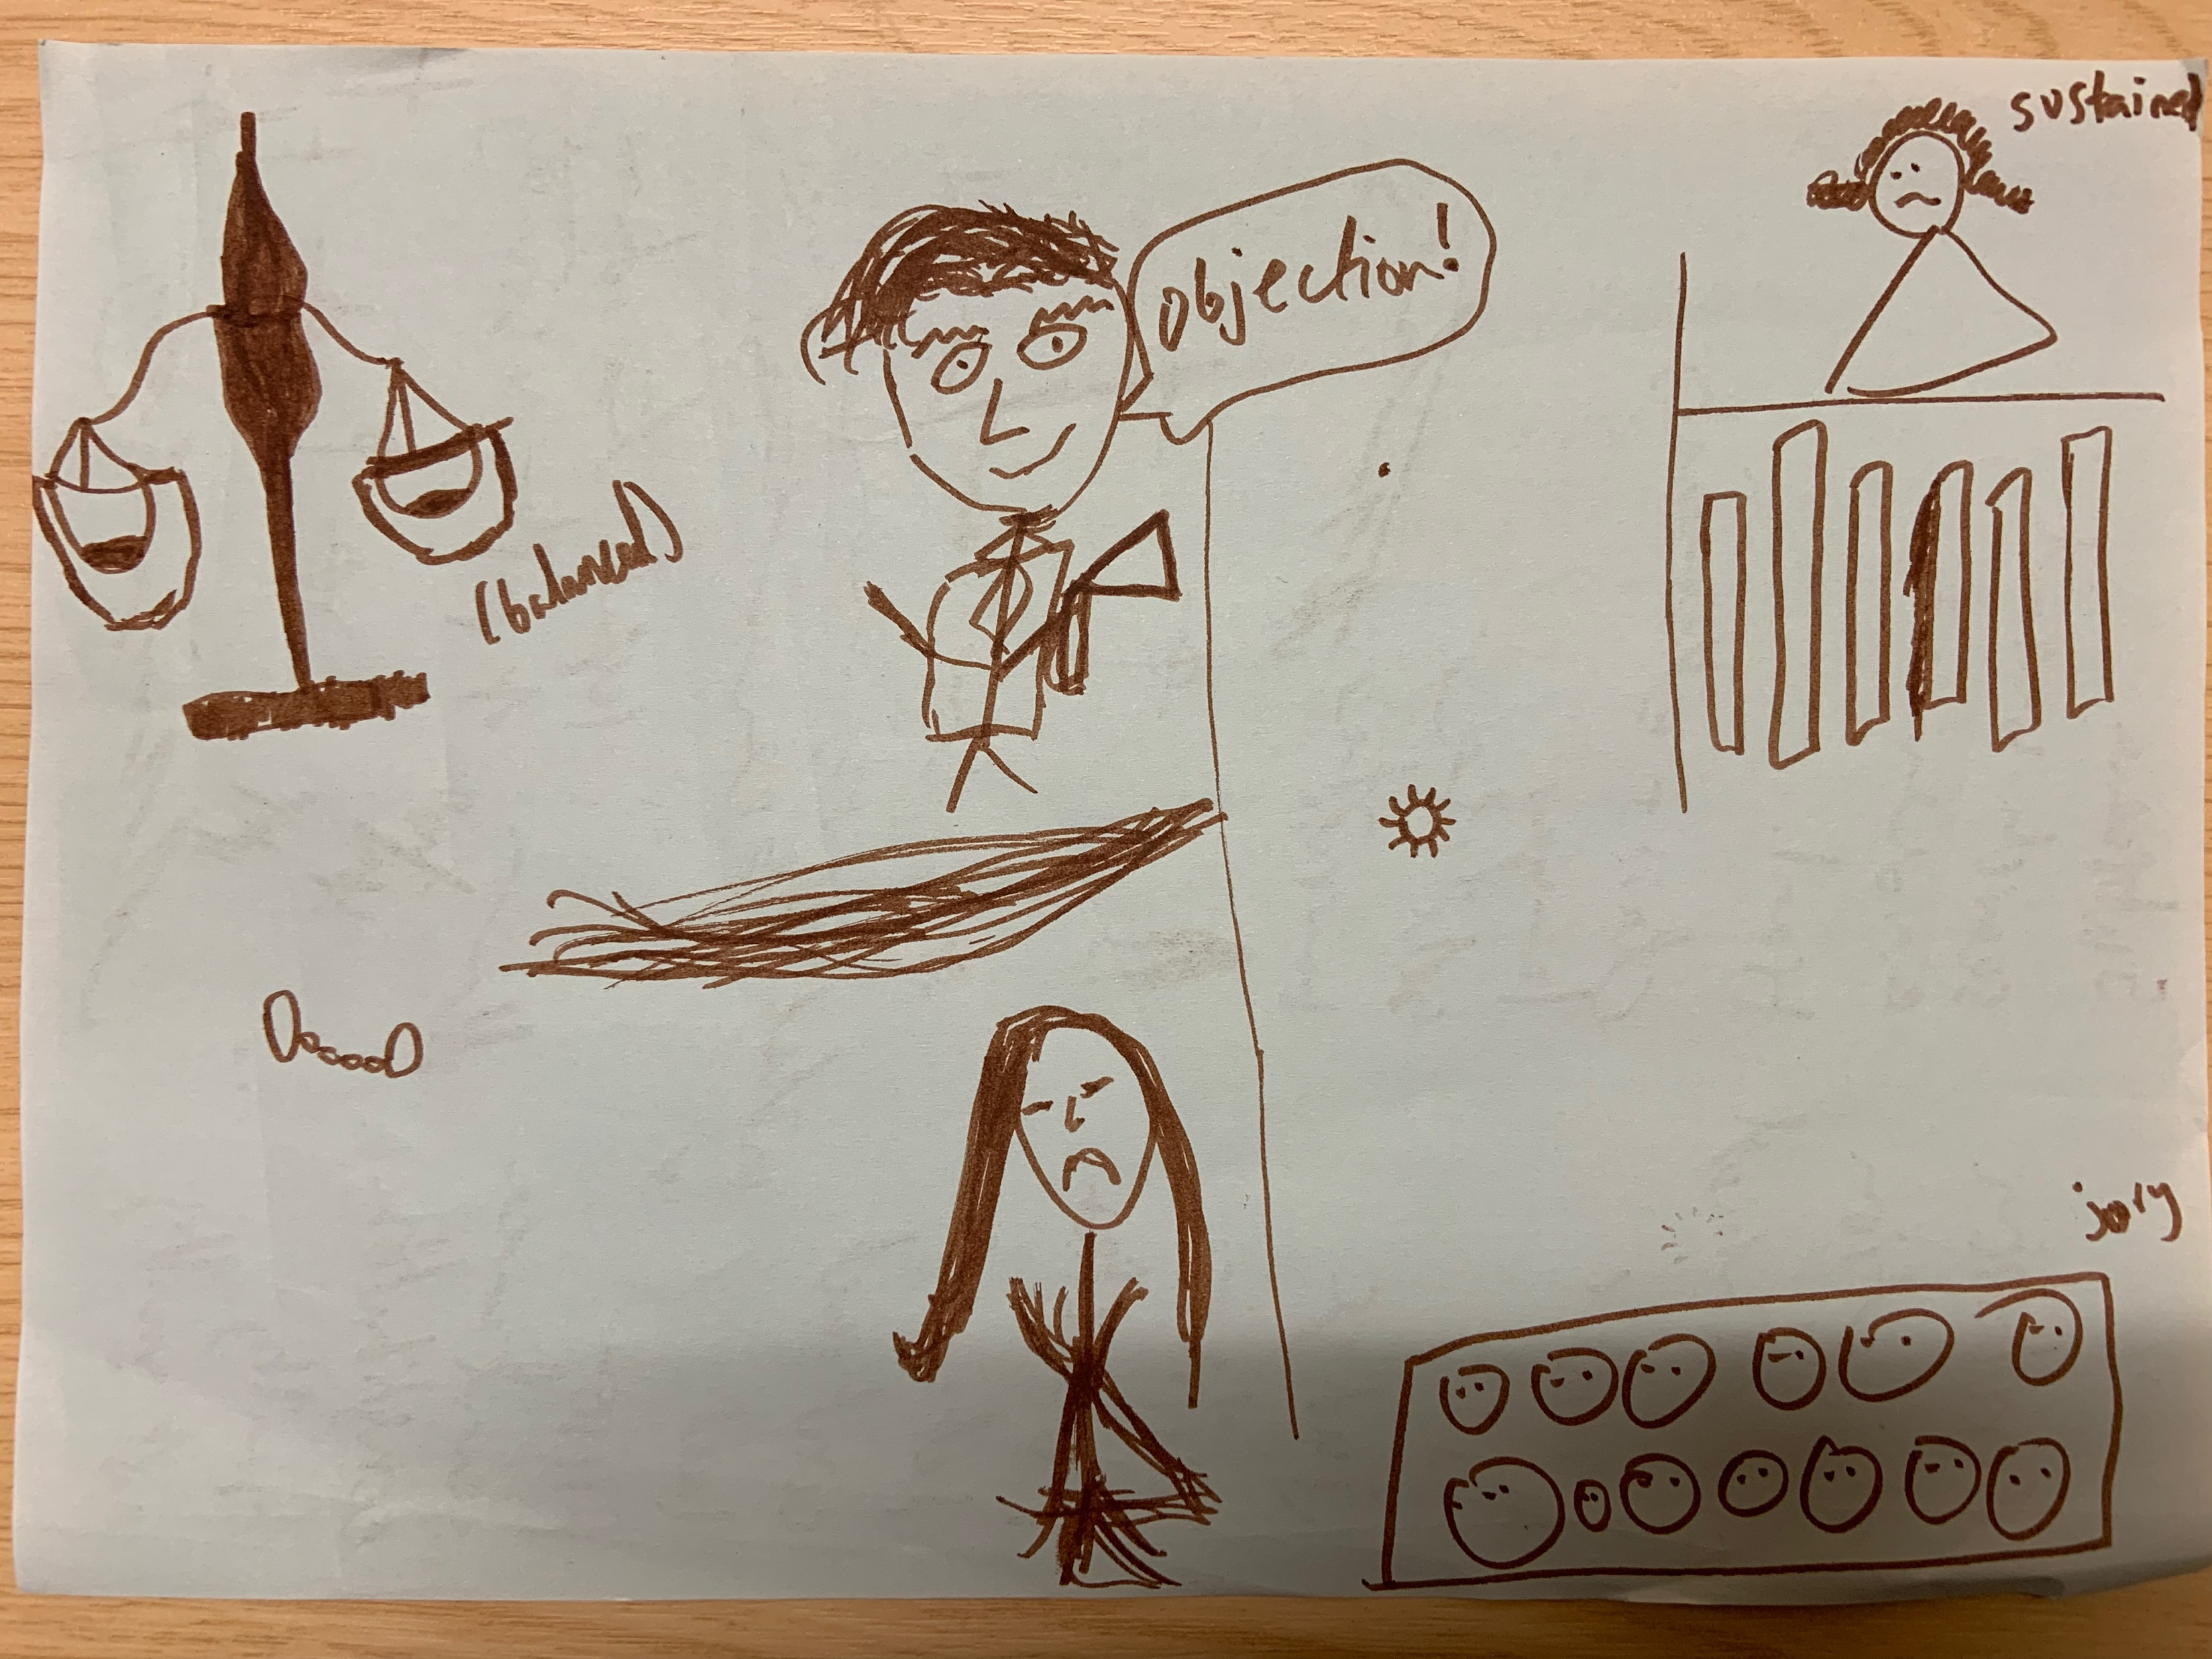
Types of game-based learning
Drawing what is law
Taskmaster
Let’s Legislate!
Flash cards
Who can find … the quickest? – Quiz
Pin the court on the court hierarchy
Parliamentary sovereignty top trumps

Slide 4
Assessment
Previous assessment – Class test & case critique presentation
New assessment – Class test & reflective assignment
Reflective Assignment 1250 words (excluding footnotes, bibliography and appendix) (60%):
Reflect on TWO skills you have developed throughout the module (Foundations of Law) during the workshops and discuss how these link to the wider legal context.
Why a reflection?
Increase attendance and engagement
Allowed the teaching approach to be directly applicable to the assessment
Get students to truly look at not just the content of the module but how its fits in a wider context
Going beyond knowledge for assessment – why are we learning this? What does it have to do with assessment?

Slide 5
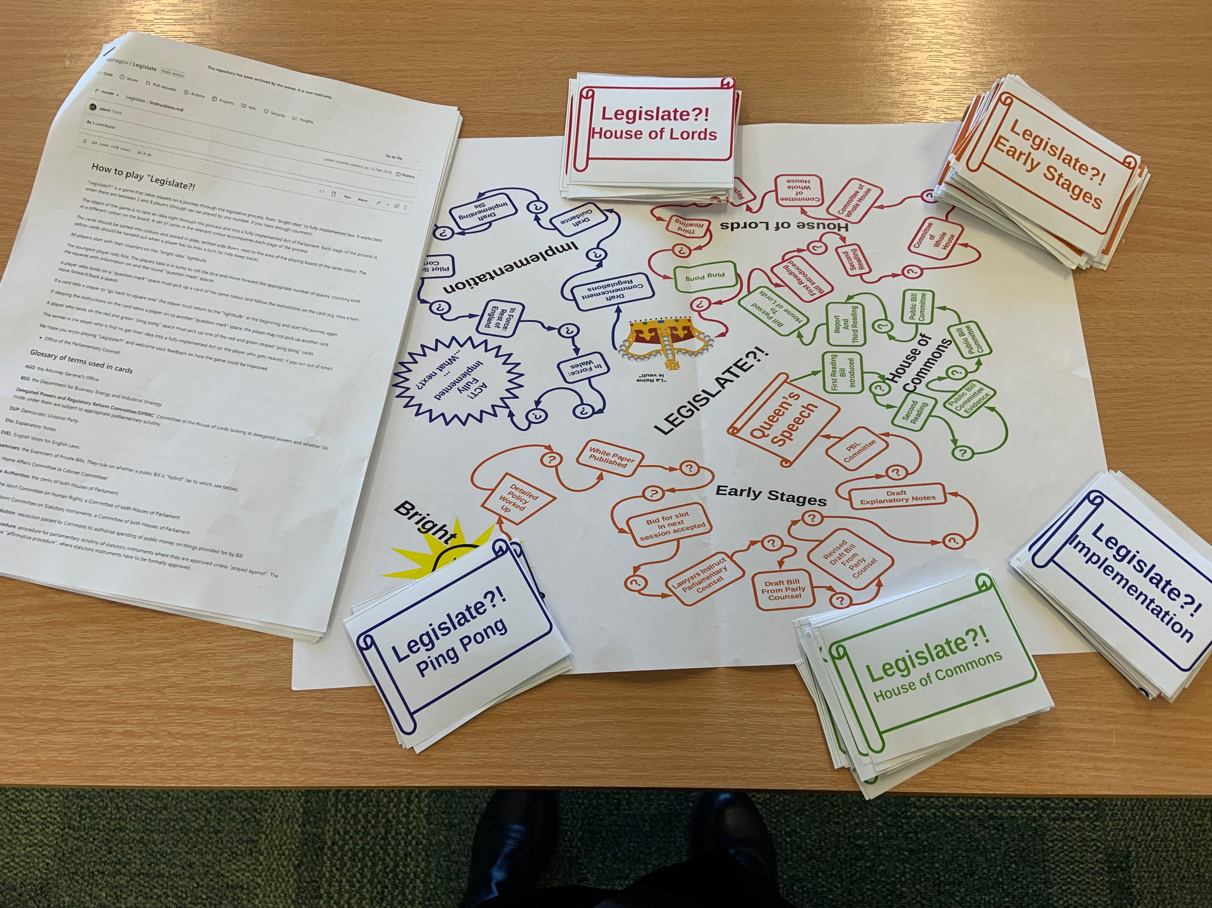
What I was expecting
Drawing what is law?
Skill: understanding what law is?
Wider links: everyone's understanding of law differs depending on their background; debunking legal myths; different types of law
Taskmaster
Skill: Statutory interpretation
Wider links: the role of those working in law is to interpret the law; good lawyers will interpret the law in a way that might not have been obvious; working with others to help solve the ‘problem’
Let’s Legislate!
Skill: Understand how legislation is made
Wider links: the role of those working in parliament, the civil service & different workings of parliament; the problems of creating legislation; thinking about changes to the law
Flash cards
Skill: How to answer problem questions
Wider links: dealing with a legal issue; understanding AR and MR; working with legislation.gov/Westlaw/Library search

Slide 6
During workshop three we learned about statute law, what it is and how it is created. We started by learning about acts of parliament and delegated legislation as well as brief overview of the House of Commons and House of Lords. The tasks we did within this workshop was to share with the class our bright idea for a change in law or for a new law to be created as well as the legislation game. When we first started this workshop, I was confident due to my prior knowledge from A Level law however this quicky changed as I realised that this was a much-needed revisit to the topic which would help to enhance the knowledge that had previously been overlooked and forgotten. When we were doing the tasks, I was nervous to share my thoughts with the class and felt that my answers wouldn’t be adequate enough. In addition to this when we moved on to the legislation game, I was extremely anxious to be working with a group of people that I didn’t know. Once I had gotten acquainted with the people within my group, I found it easier to talk and discuss with them …. It allowed for me to gather an understanding on the subject which before had been missing, especially during the legislation game … The skill that I gained from this workshop in being able to identify statute law and know how it is created will help me within a wider legal context as learning about how statute law is created is learning how legislation is made and without the skills learned from this workshop there would be no way to progress further within law. In addition to this reflecting has allowed me to see that I need to work on my public speaking within the workshops which would be needed in a wider legal context as public speaking is a necessary professional skill.

Slide 7
What I got
The good
The not so good
Discussion of how the tasks took them outside their comfort zone and gained important skills of ‘thinking on your feet’
Significant reference to the skills they had learnt, which I had not considered
Reflection on A Level law for example
Abbreviation chart
Acknowledgement that this form of teaching helped them in the learning process
Random activities that were not included in any of the sessions
More on the ‘what’ aspect’ rather than the ‘so what’
Answer where students had not attended sessions (used pre-recordings to answer the question)
A sentence of reflection
Repetition of knowledge

Slide 8
My own reflections
Support for writing reflectively
Assessment link and necessity – yes
What about those who do not attend?

Slide 9
Top tips
Make it clear at the start how the games link to knowledge you wish for them to walk away with, alongside some of the skills
Play the radio in the background
More support with reflective writing – done my ML ideally
Back up plan for those who do not attend
Formative element
Marking criteria that fits the method of assessment

